Slide 1
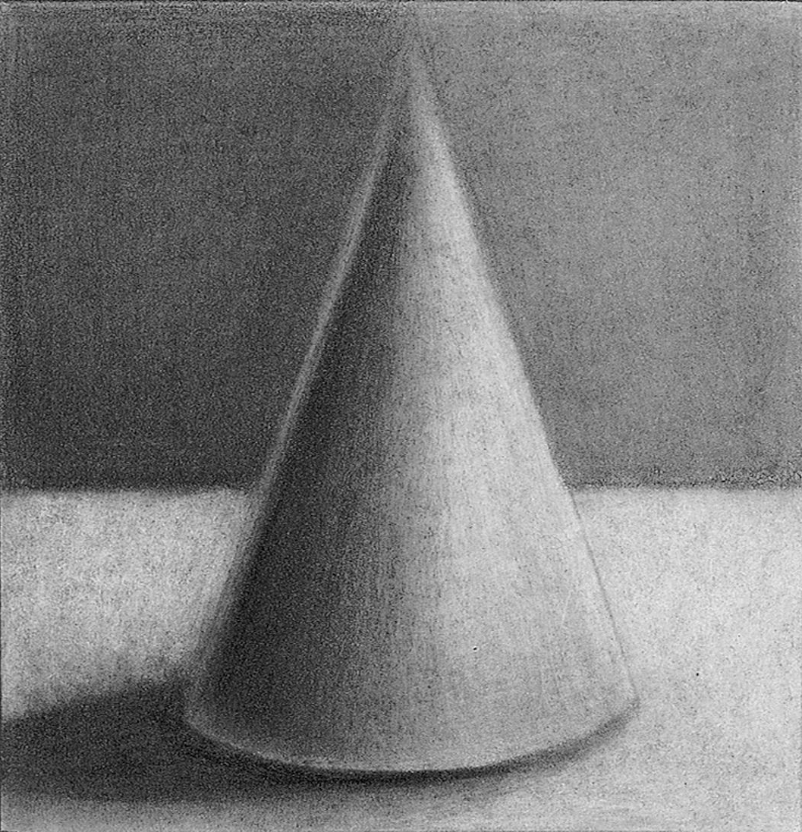
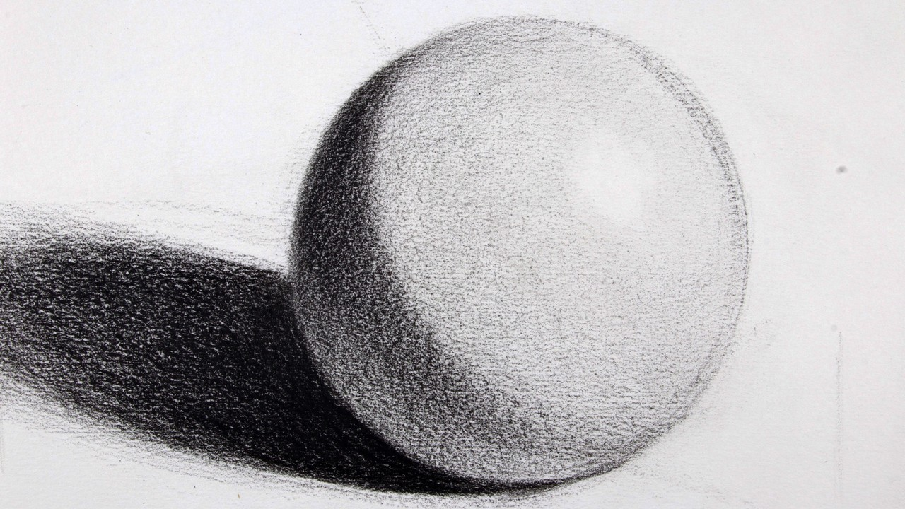
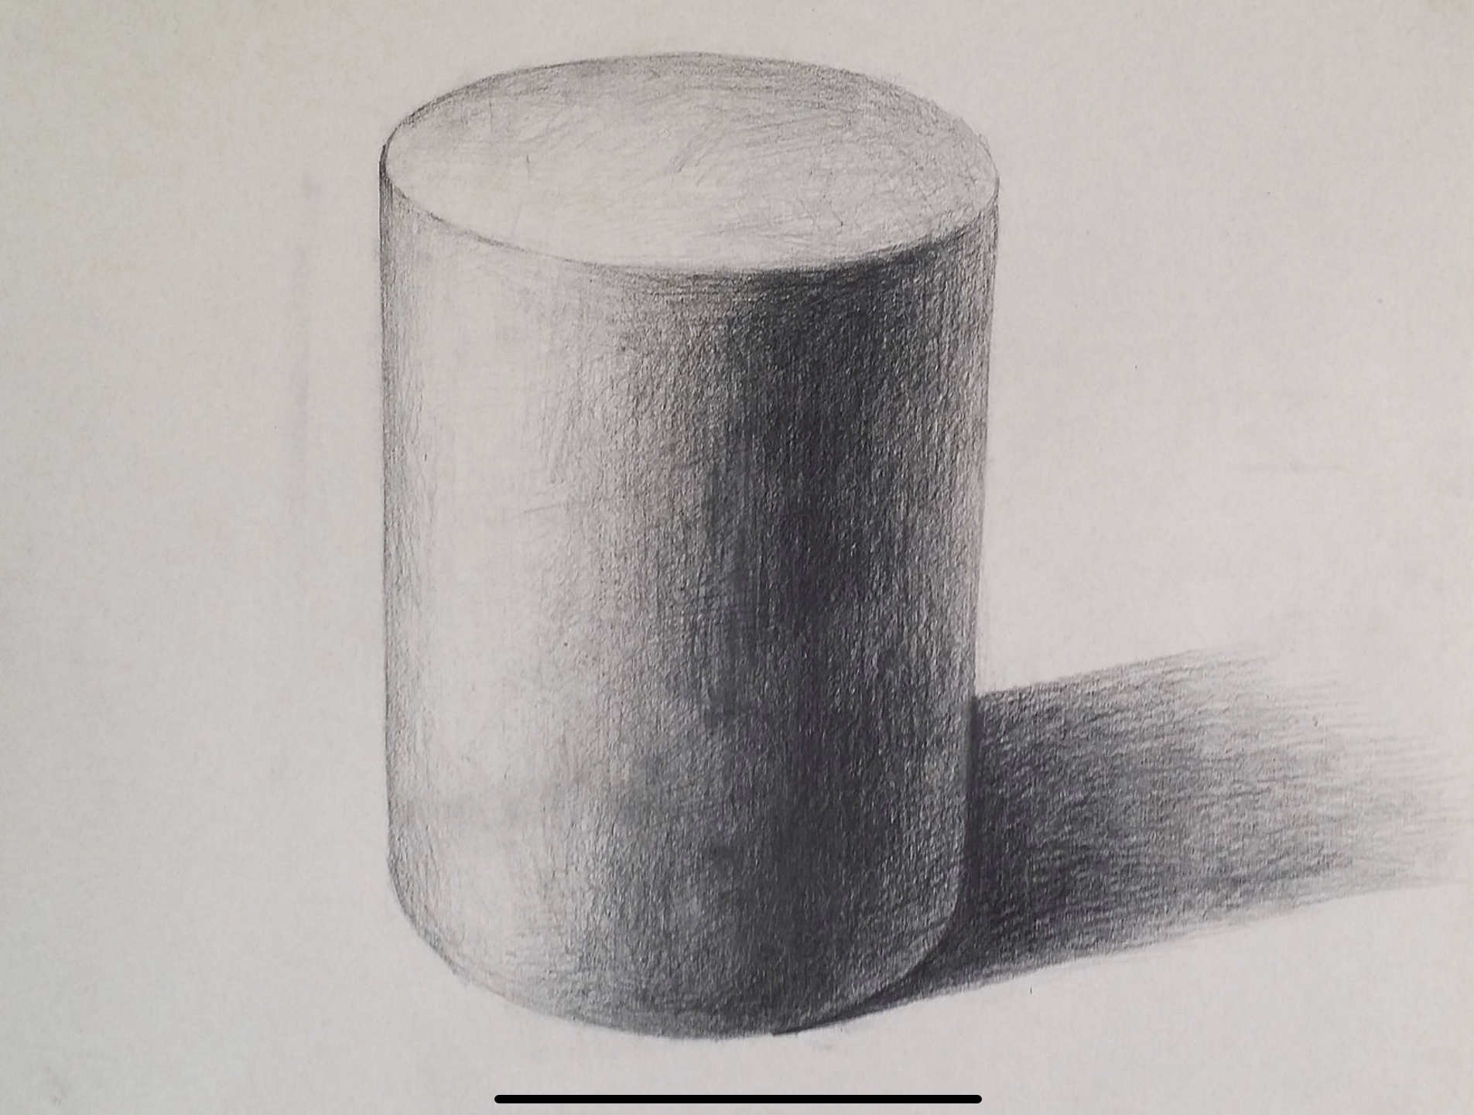
Task: Draw the shapes on the following two slides. Use a full tonal range. Look carefully at the light and dark areas and replicate them to your best ability.
Why: Successful use of tone will make your drawings look 3D, more accurate and realistic
Success Criteria
You have drawn four shapes
The change in tone is smooth
Add shadows to show form.
Challenge Element
Create a drawing with multiple shapes together, how would they interact?

Slide 2
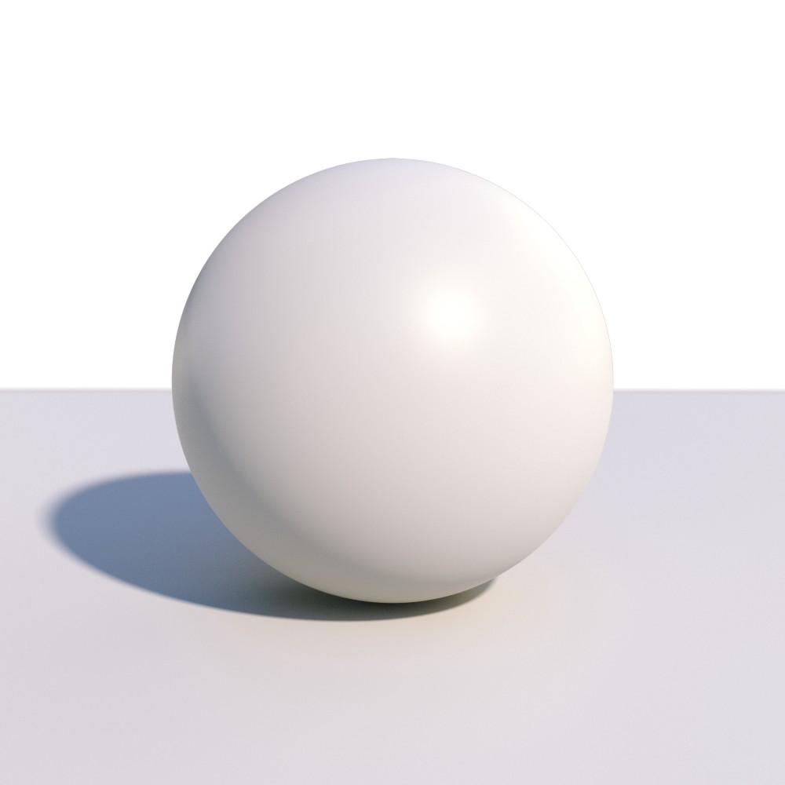

Slide 3
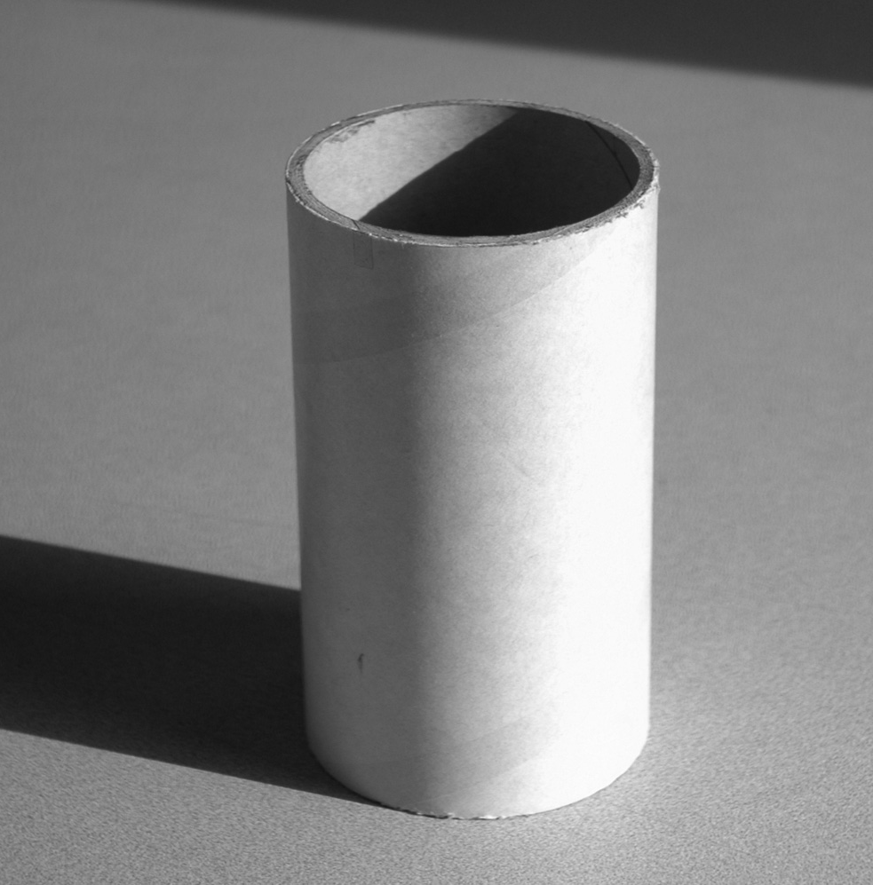

Slide 4
Task: Follow the step-by-step instructions to draw an eye.
Success Criteria
The shape of the eye is similar to a squashed lemon
There are areas of very dark tone, white paper and full range of mid-tones
The light reflections are well defined
Challenge Element
Continue the drawing to include eyebrows and under eye.

Slide 5
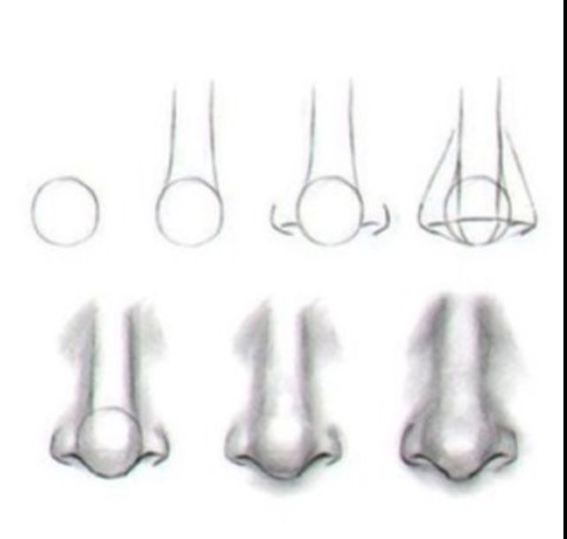
Task: Follow the step-by-step instructions to draw a nose
Success Criteria
Start with a circle drawn in light pencil
Use a full tonal range from black to white, including mid-tones
Blending of tones is smooth
Challenge Element
Combine this task with the previous task and draw a nose and eye together. Think about how you could show the curves of the face.

