Slide 1
Welcome to Personal Development
What is Personal Development (PD)?
PD is where we take a break from the thought of GCSEs and think about life instead.
You may call it PSHE/ citizenship/ Be Spirited or a variety of other subjects in middle school.
We will look at things like:
Who makes us the person we are?
What is right and wrong? Who decides?
How do we form relationships, and how do we know whether they are healthy?
How can we look after ourselves; physically and mentally?
What does it mean to live in Britain?
How can we be kinder?

Slide 2
Think about these questions….
What makes you the same as other people?
What makes you different to others?
How do we become who we are?

Slide 3
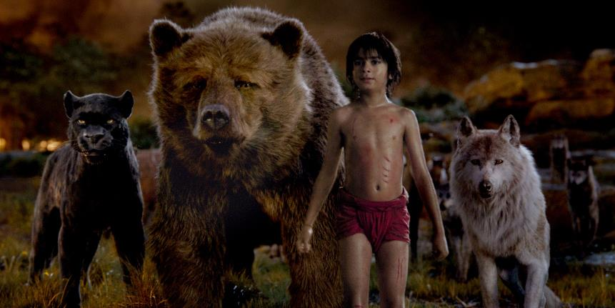
Do you know the Jungle Book story?
https://www.youtube.com/watch?v=5mkm22yO-bs
How does Mowgli act differently to other children?

Slide 4
Did you know that the Jungle Book is based on a true story?!!!!?

Slide 5
Which of the following stories of children being raised by animals do you think are true, and which do you think are false?

Slide 6
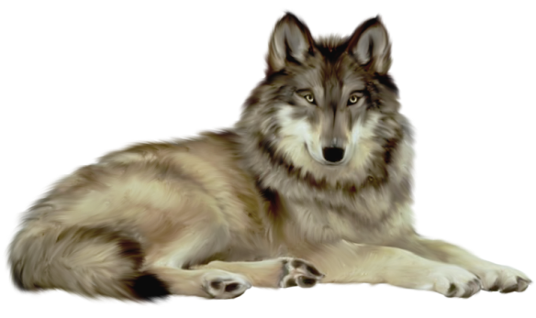
Dina Sanichar,
the Indian Wolf Boy

Slide 7
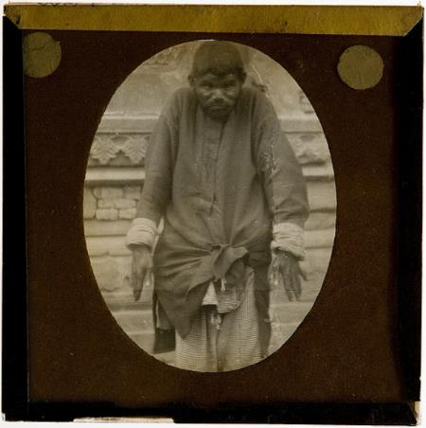
Dina Sanichar, the Indian Wolf Boy
Date found: 1867 Age when found: 6 Location: Sekandra, India Years in the wild: 6 Animals: wolves

Slide 8
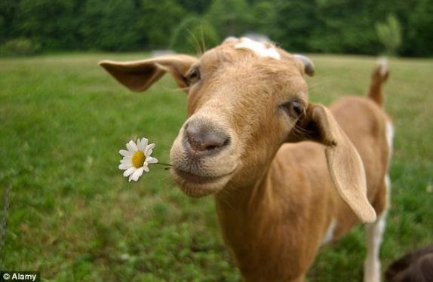
Daniel,
The Andes Goat Boy

Slide 9
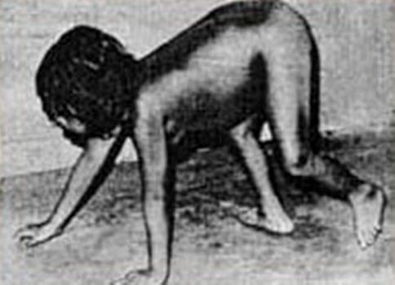
Daniel, The Andes Goat Boy
Date found: 1990 Age when found: 12 Location: Andes, Perú Years in the wild: 8 Animals: goats

Slide 10
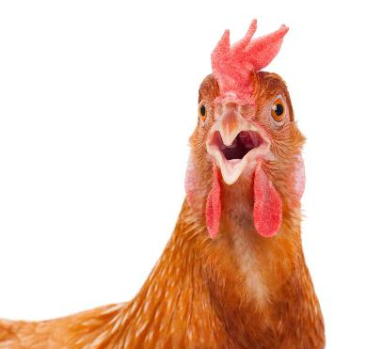
Patrick,
the Chicken Boy

Slide 11
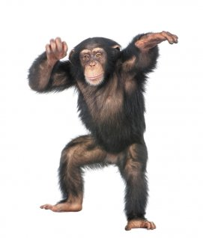
John Ssebunya, the Ugandan Monkey Boy

Slide 12
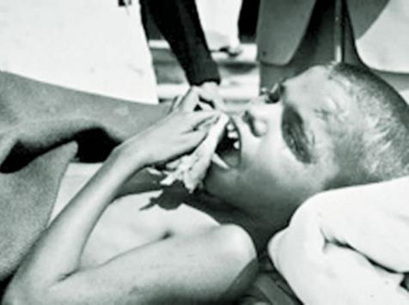
John Ssebunya, the Ugandan Monkey Boy
Date found: 1991 Age when found: 6 Location: Uganda Years in the wild: 3 Animals: monkeys

Slide 13
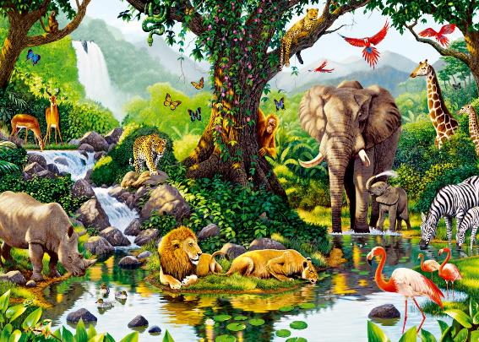
Rochom P’ngieng, Cambodian Jungle Girl

Slide 14
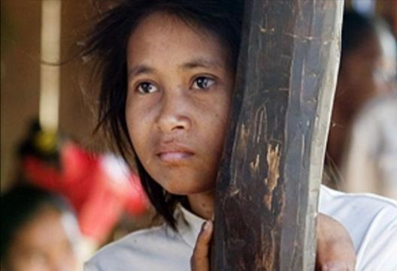
Rochom P’ngieng, Cambodian Jungle Girl
Date found: 2007 Age when found: 29 Location: Cambodian Jungle Years in the wild: 19 Animals: various animals

Slide 15
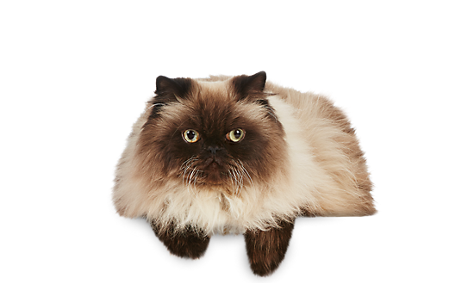
Gracie, Cat Girl

Slide 16
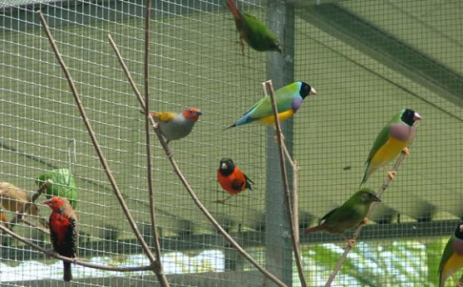
The Russian Bird Boy

Slide 17
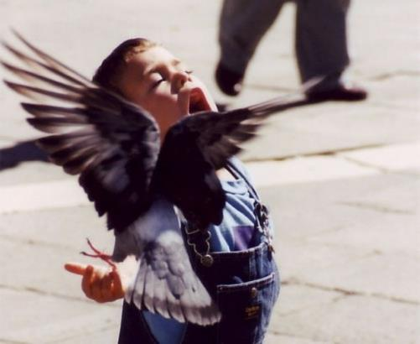
The Russian Bird Boy
Date found: 2008 Age when found: 7 Location: Volgograd, Russia Years in the wild: 7 Animals: birds

Slide 18
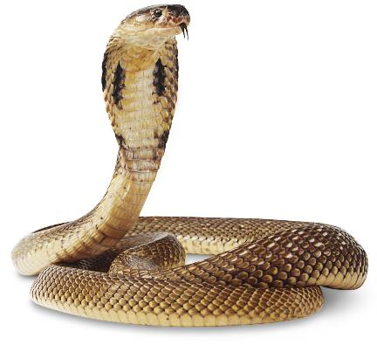
The Australian Snake Boy

Slide 19
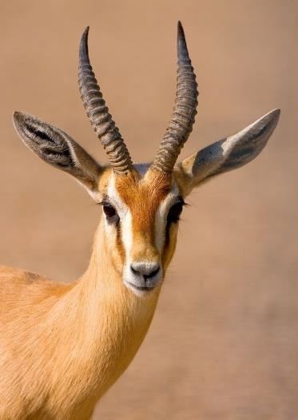
The Syrian Gazelle Boy

Slide 20
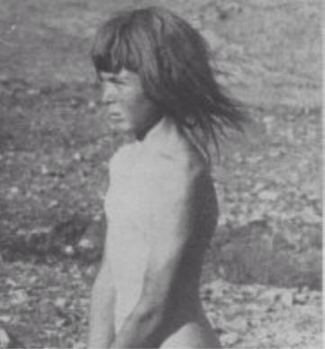
The Syrian Gazelle Boy
Date found: 1946 Age when found: around 10 Location: Syrian desert Years in the wild: 9 Animals: gazelles

Slide 21
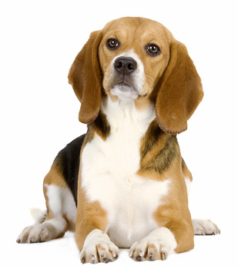
Oxana Malaya, The Ukrainian Dog Girl

Slide 22
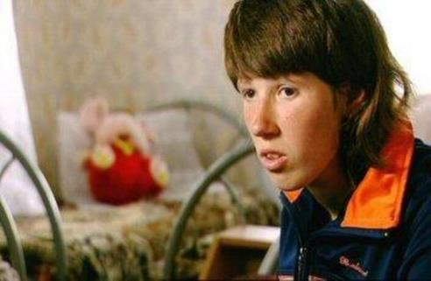
Oxana Malaya, The Ukrainian Dog Girl
Date found: 1991 Age when found: 8 Location: Blagoveshchenka, Ukraine Years in the wild: 5 Animals: dogs

Slide 23
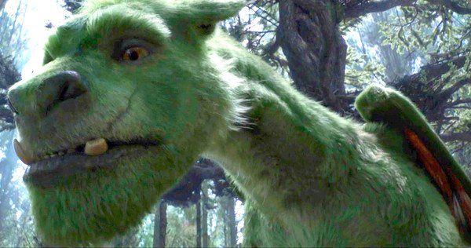
The American
Dragon Boy

Slide 24
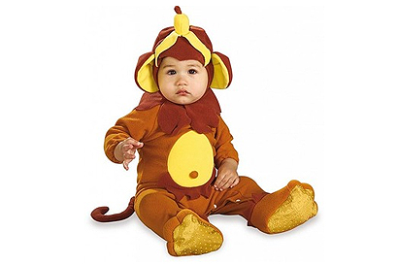
Nuture
The way we are brought up can make us who we are.
If children are raised by animals they will act like an animal.
What if a child wasn’t raised by anyone or anything?

Slide 25
Genie
Read the case of Genie on the next slide.. How does this make you feel?

Slide 26
Genie was found by a social worker in 1970 in Los Angeles when she was 13 years old. She had spent all of her life locked in a small room in her house, by her father. A lot of the time she was strapped naked to a potty chair. Both of her parents were charged with abuse. Psychologists tried to help Genie to learn, because she could not walk or talk. They found that they could teach her words, but that she couldn’t learn to talk in sentences. It seems that she missed an important part of her childhood, which is the only time we can learn to do things like form sentences.

Slide 27
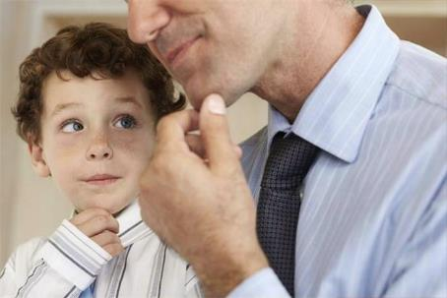
Nuture
How we are brought up is called our socialisation.
Part of our learning comes from imitating others.
In what ways might you imitate your friends?

Slide 28
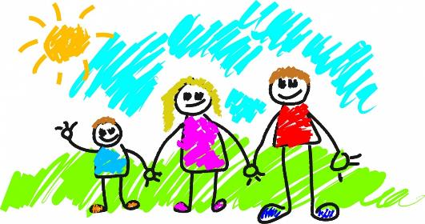
Nuture
We learn lots from the other people around us.
Until we are about 4 or 5 the main people to teach us are our family.
What do we do at age 4 or 5 that then might affect who we learn from?

Slide 29
Nuture
So the children we looked at who were socialised by animals, behaved like animals.
Genie had no socialisation, so did not know how humans behaved.
But other than nurture, what else can make us act the way we do? Could it be to do with what nature gave us? Our instincts? Do we sometimes act how we do, because we just know that’s what we should do?
Let’s look at some examples….

Slide 30
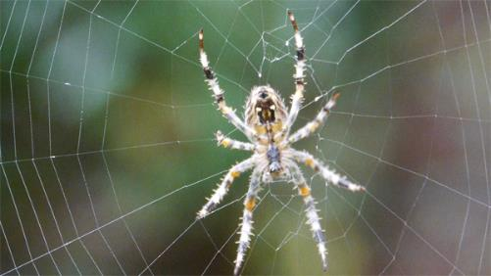
Instinct
Nature
Bird building nest
Spider spinning web
Turtles returning to the sea when they hatch
Ducklings follow their mother. This is called imprinting
Birds migrating

Slide 31
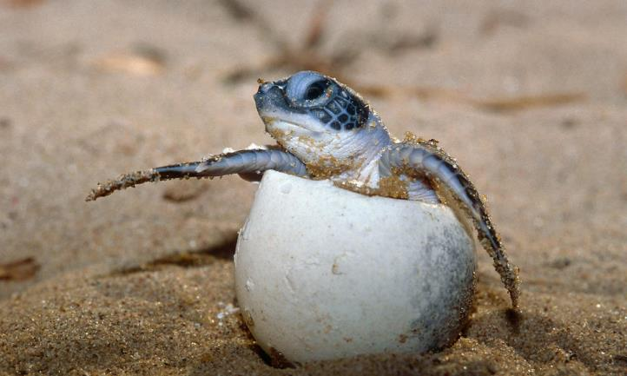
Instinct Cute video alert!
https://www.youtube.com/watch?v=w82xpBR_Z4A

Slide 32
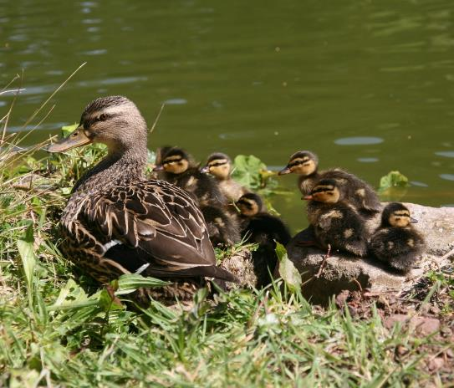
Instinct Cute ducks imprinting on their mum
https://www.youtube.com/watch?v=5BMgkwvIIeA

Slide 33
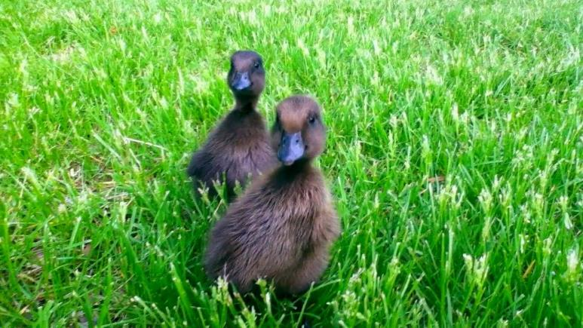
Instinct Cute ducks ‘thinking’ they are imprinting on their mum?!
https://www.youtube.com/watch?v=MP6SlDSfcLE

Slide 34
I hope this have given you a taste of what to expect in PD, and that you are looking forward to your lessons. We can’t wait to meet you, and start discussing.

