Slide 1
Hello Year 8 and WELCOME to the study of History at Monkseaton High.
We are a Time Team ☺
To get you thinking about the 20th Century (1900-1999) which is what we cover in Year 9, here are some tasks to help you discover the …
Terrific 20th Century!
When you complete the tasks, please email your work to:
Y8transition@monkseaton.org.uk
Notes:
Play song on entry

Slide 2
Task 1
“you got a whole lot o’ History”
Here are some interview questions from us to you …
What’s your story?
Which time period have you been most interested in so far in your lessons?
What’s the best piece of work you’ve done in history lessons and why?
If you could dress up as any historical character who would it be and why?
Would you rather have been a gladiator in the Colosseum or a pirate in the Caribbean? Why?
If you could meet anyone from the past, who would it be and why?
What’s the best historical site you have ever visited?
Which historical site would you like to go and explore?
What is your most memorable moment from middle school?
https://www.youtube.com/watch?v=yjmp8CoZBIo

Slide 3
Task 2 – look at the pictures at the end of the PowerPoint then write as many events, people and changes in this circle as you can
The 20th Century
Think
Notes:
Draw and fill circle … what do you know? Then in the outer square … how do you know it?

Slide 4
Task 3 – now research and put these events, people and changes in chronological order
(order of time)
Date | Event | Date | Event
1903 |  | 1948
1905-18 |  | 1952
1908-27 |  | 1953
1914-18 |  | 1953
1933 |  | 1950s/60s
1937 |  | 1955
1939-45 |  | 1963
1940 |  | 1966
1945 |  | 1969
1945 |  | 1977
1947 |  | 1984-5
1947 |  | 1989
1948 |  | 1997
Think
Notes:
Draw and fill circle … what do you know? Then in the outer square … how do you know it?

Slide 5
Task 4: identify 3 themes and sort some of the pictures into these categories
e.g. technology
20th Century
Think
Notes:
Thinking tree – categorise e.g. triumph, tragedy, mixed …. People, places, events … communication, warfare, travel … political, economic social
Creative, necessary, harmful

Slide 6
Task 5: Choose 2 events / people / developments
How are they similar?
Different?
Different?
Think
Notes:
Compare and contrast … do on the white boards … and groups to justify.

Slide 7
Task 6: Choose 2 events / people / developments and create paragraphs to explain the importance and impact of each one to the 20th / 21st Century
Describe event / person
Why was it / they were important at the time?
Why does the event / person still matter now?

Slide 8
Terrific 20th Century
Use these pictures to complete the tasks and investigate the major characters, events and developments in this century of great change, 1900-1999.

Slide 9
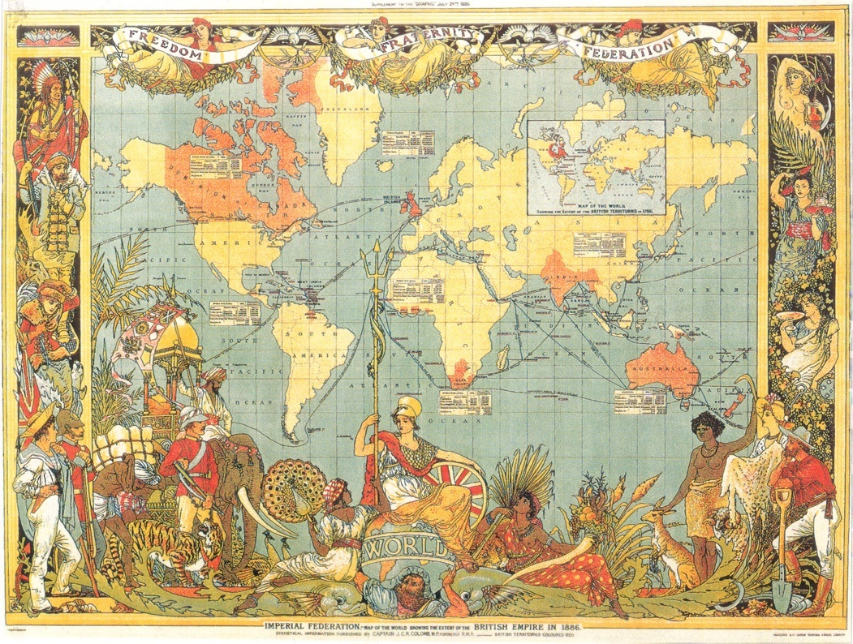

Slide 10
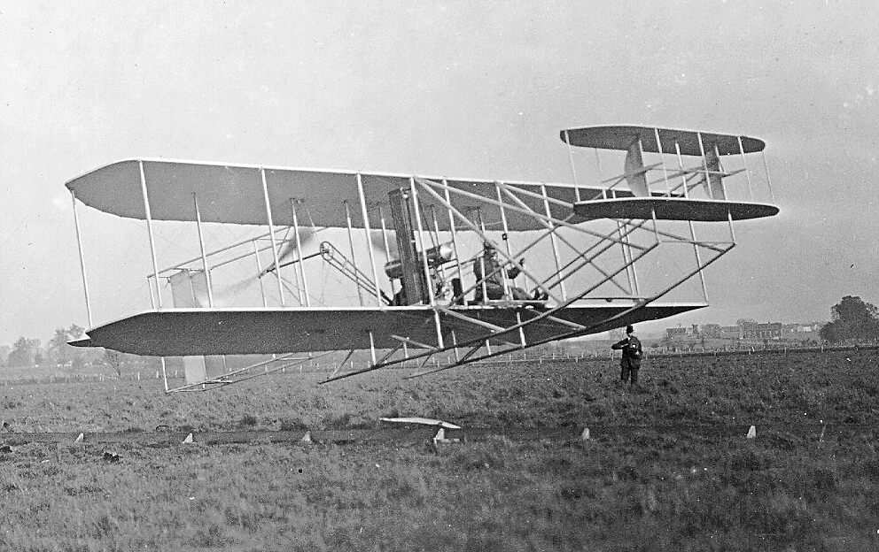

Slide 11
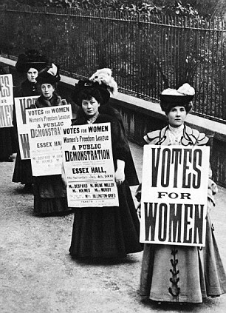

Slide 12
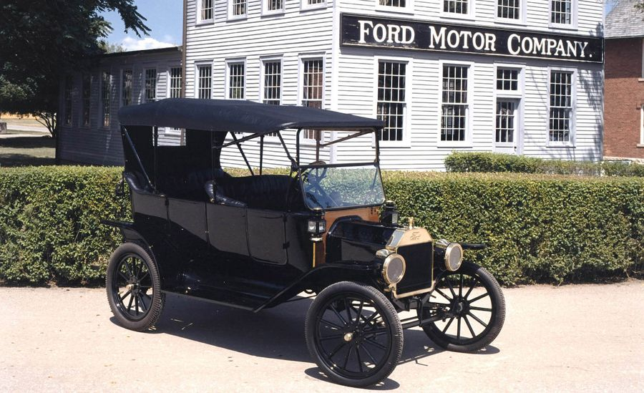

Slide 13
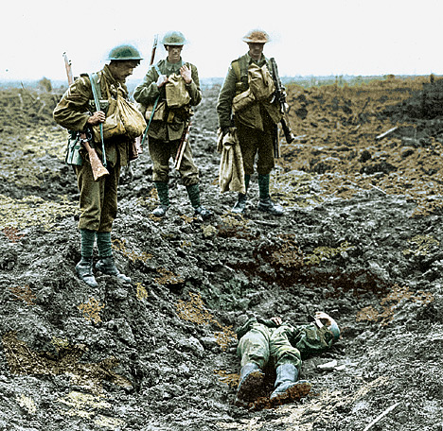

Slide 14
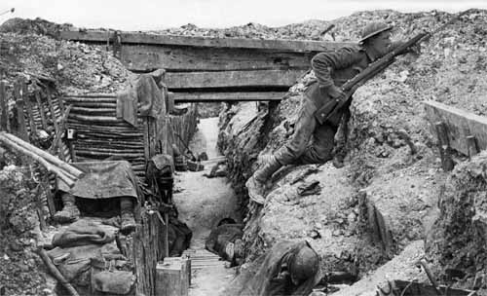

Slide 15
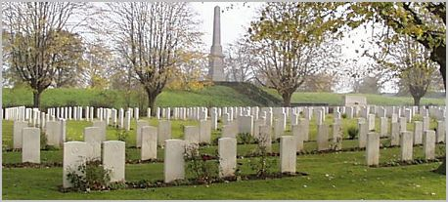

Slide 16
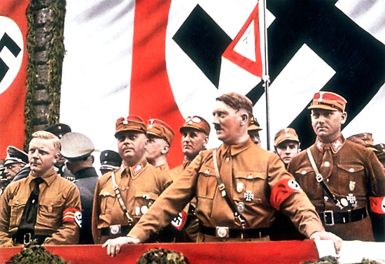

Slide 17
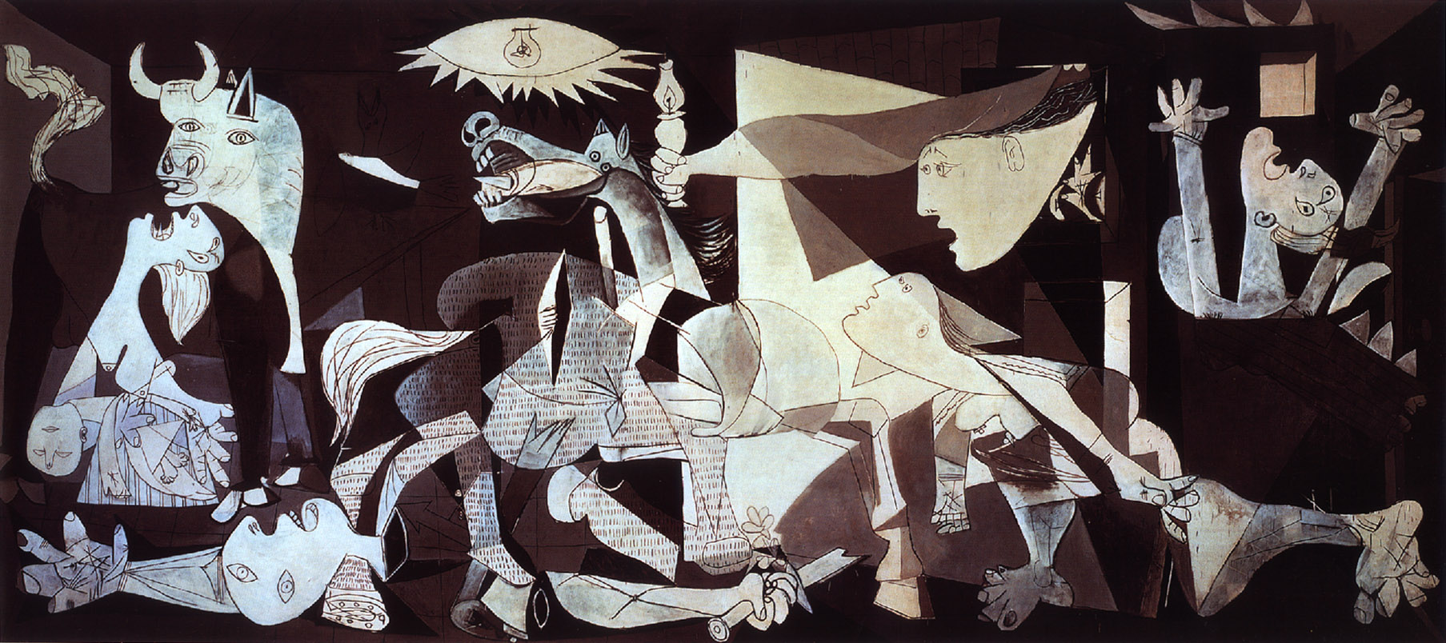

Slide 18
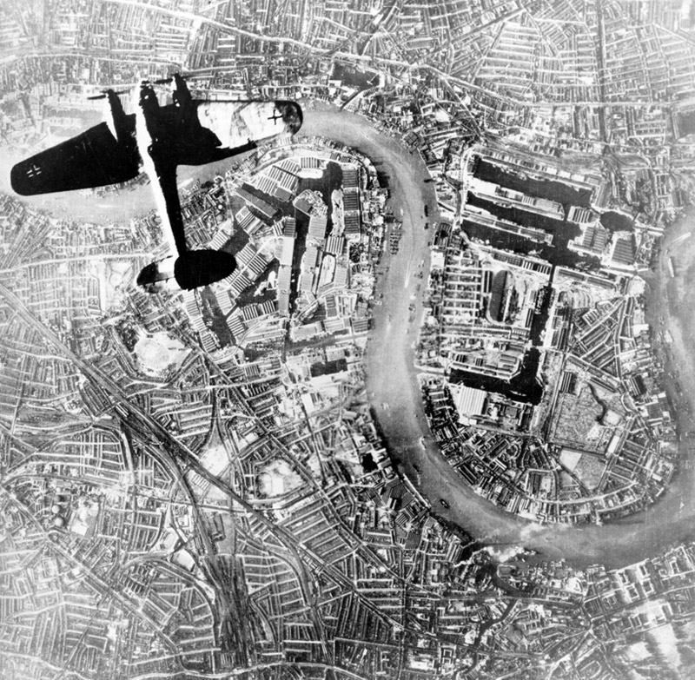

Slide 20
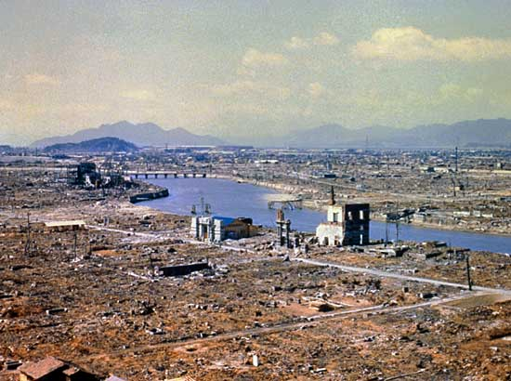

Slide 22
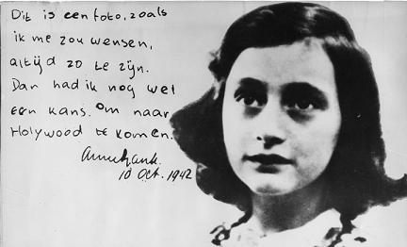

Slide 23
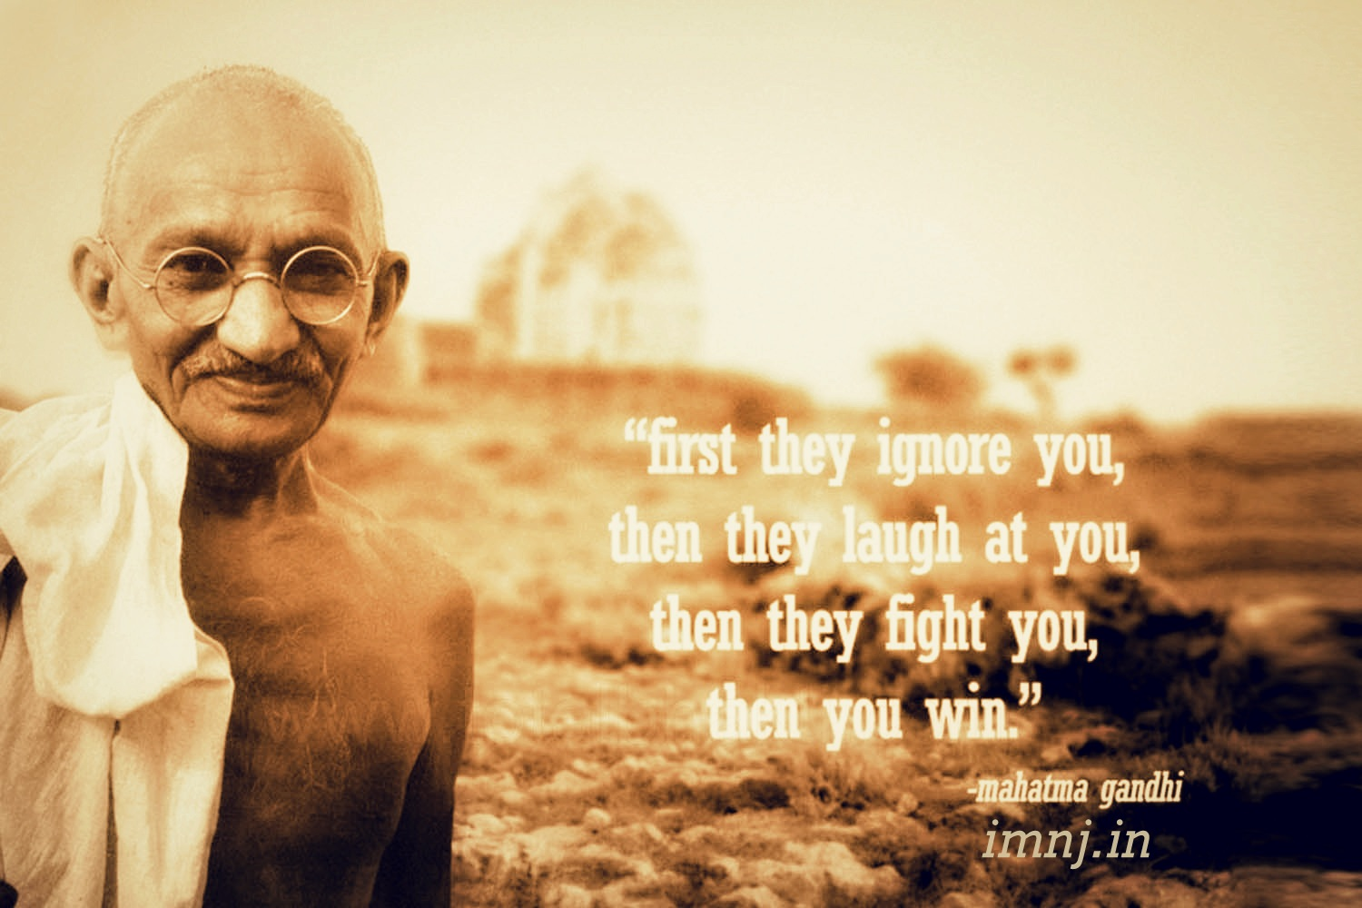

Slide 24
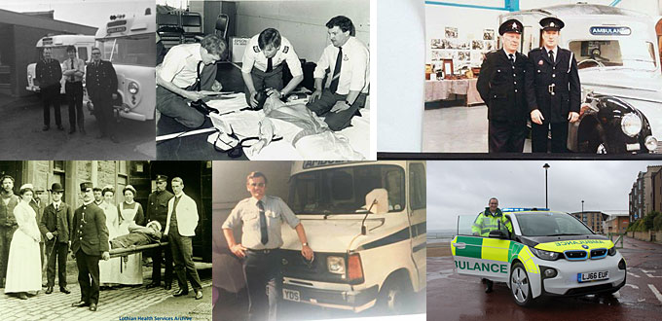

Slide 25
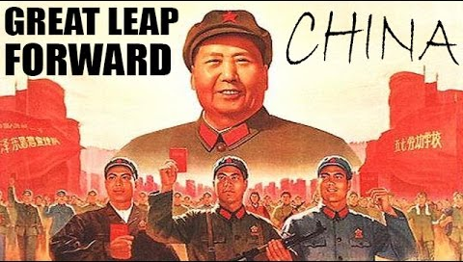

Slide 27
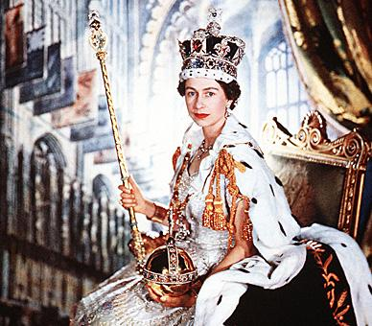

Slide 28
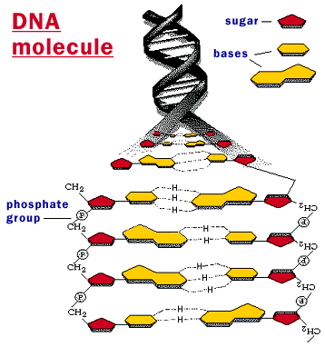

Slide 29
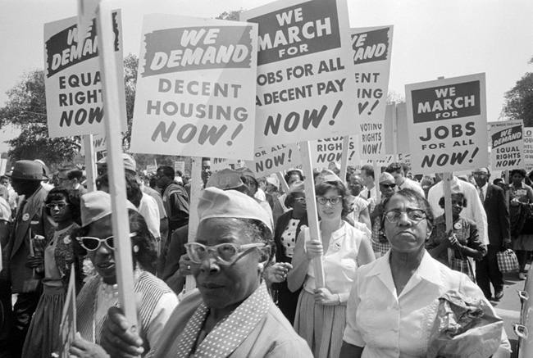

Slide 30
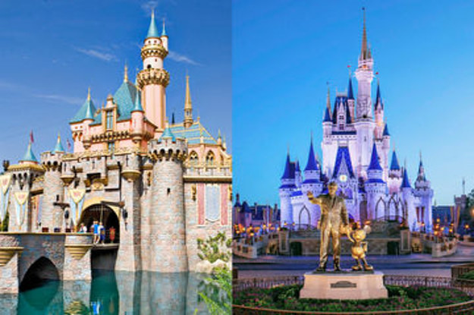

Slide 31
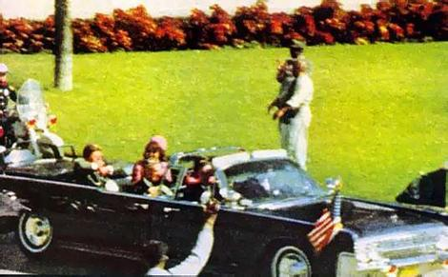

Slide 32
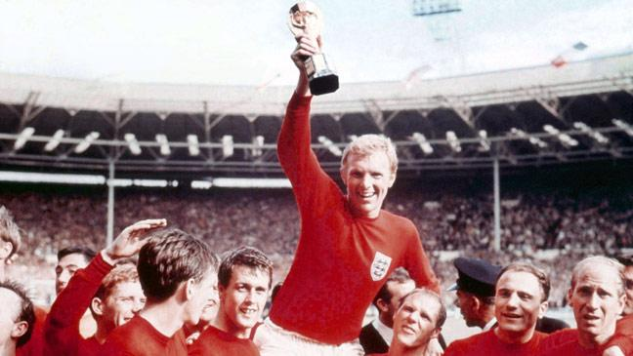

Slide 33
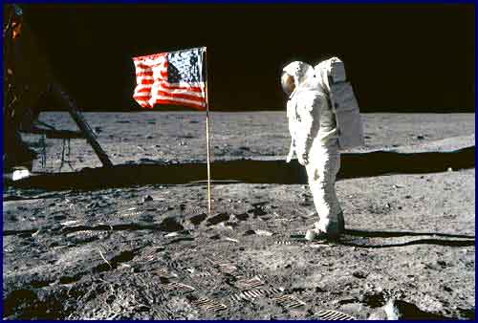

Slide 35
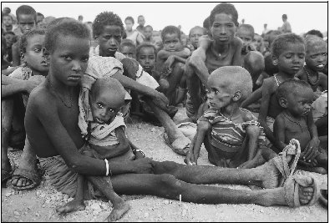

Slide 37
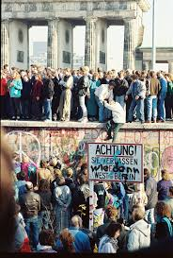

Slide 38
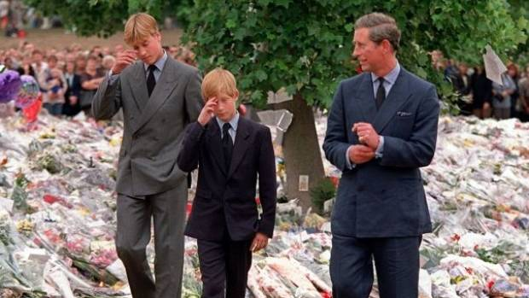

Slide 40
