Slide 1
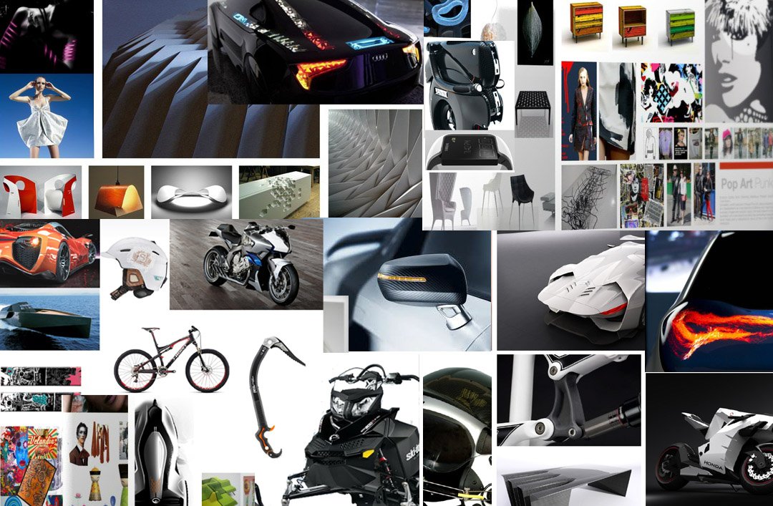
Monkseaton High School Technology
Year 8 Transition work

Slide 2
THE BIG PICTURE
Your first year in Technology
During year 9 you will use all of your existing skills at key stage 3 during year 7 and 8. We aim to take a practical approach that encourages you to design and make products with creativity and originality. We do this through exploring a variety of practical/design based activities, using a range of traditional and contemporary materials and techniques. We will also look at how materials technology have developed over time to help shape the world we live in today.
During year 9 we use the acronym of DESIGN to break down our projects across each half term
Discover: You will analyse existing products and use what you learn to help you in your own projects
Explore: Look at materials and how they are processed so your know which work best in different products (woods, metals, plastics and composite ‘smart’ materials).
Share: You will develop your visual communicate techniques so you can share ideas clearly and in different ways including using computer aided design/manufacture.
Innovate: you will develop your design ability in response to different design challenges considering design constraints (such as environment, social, moral, safety, and cost)
Genius: You will look at the history of how and why products develop and change over time. Using iconic designs to help us.
Need: You will be given a real challenging STEM project design brief with a real client. This will involve you having to design and make a solution to be fully tested and using all the skills you have developed throughout the year

Slide 3
My Selfie
Draw your own selfie in the phone below then complete the boxes below
I like
I dislike
The projects in Technology I have…
I like learning when I can
Last year in technology I made…
In Technology I am good at
My interests are…
In Technology I need extra help with

Slide 4
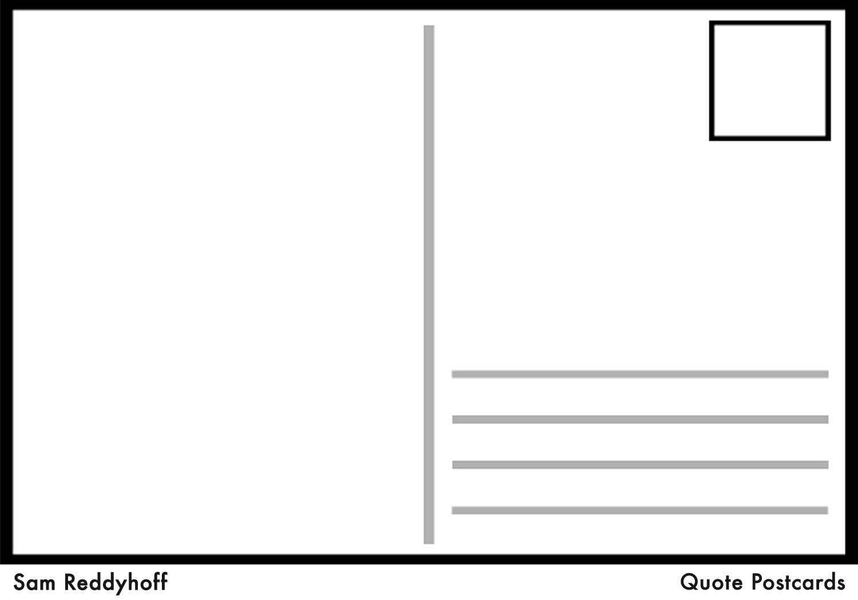
Postcard to Me
Tell me what you would say to yourself at the end of year 9

Slide 5
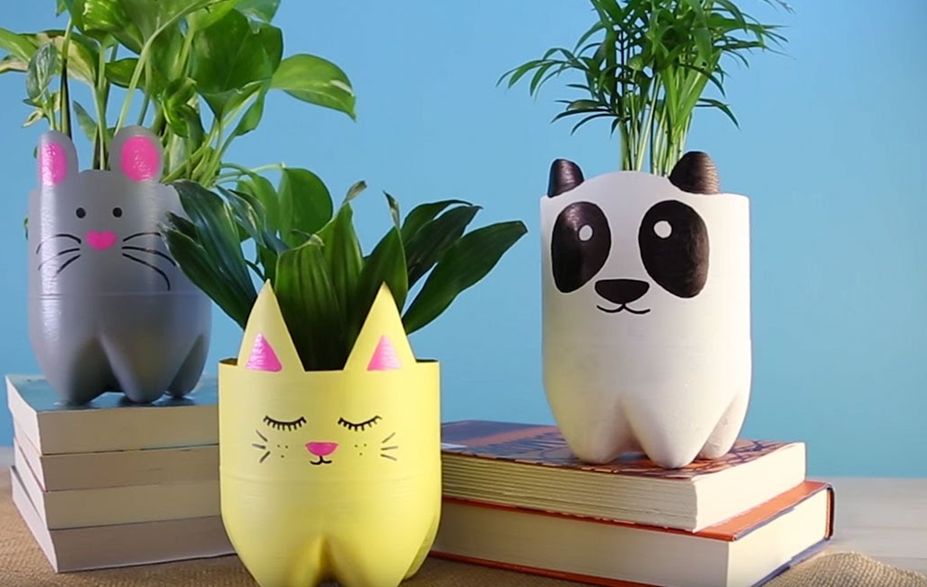
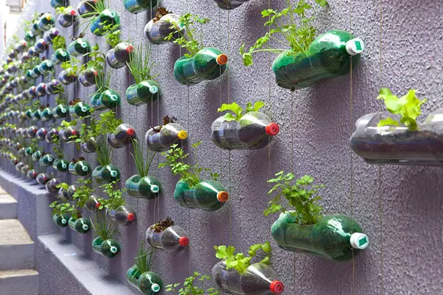
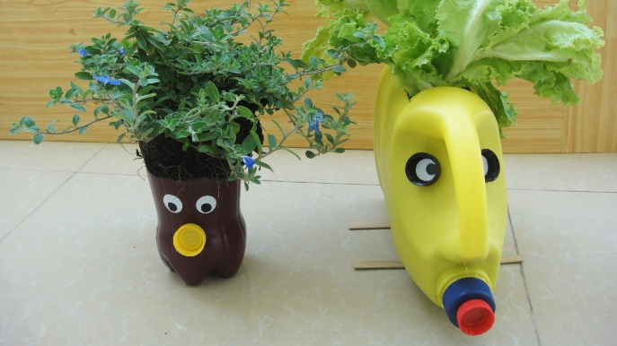
Planter Project Transition project
Lesson Objectives
To learn and apply effective research techniques.
To develop communication of ideas and apply creative thinking techniques.
To apply practical skills to a make physical model.
To evaluate effectiveness of design solutions and make improvements.

Slide 6
Planter Project : Research
Activity 1
Using the table and information you have seen list all of the good things about recycling and the bad things.
Watch the following video clips
https://www.youtube.com/watch?v=_6xlNyWPpB8
https://www.youtube.com/watch?v=erGnf7ws20E
https://www.youtube.com/watch?v=glAPkpeKvfE
Good | Bad
Research is the essential starting point to any project. So first things first, what do we need to know before starting this project? We probably need to work out the following things;
What is the impact of plastic bottles being disposed of?
why is food packaging being recycled?
Climate change.
What is sustainability?
What are the 6 r’s?
In your opinion is recycling good or bad? Justify your answer in the box below.

Slide 7
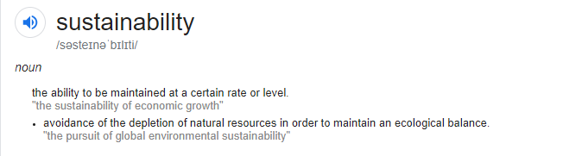
Planter Project The 6 R’s of Sustainability
https://www.youtube.com/watch?v=luE5Aeqjf1Q
The 6 R’s | Explanation and example of how you could do this at home
Reduce
Refuse
Repair
Recycle
Re-use
rethink

Slide 8
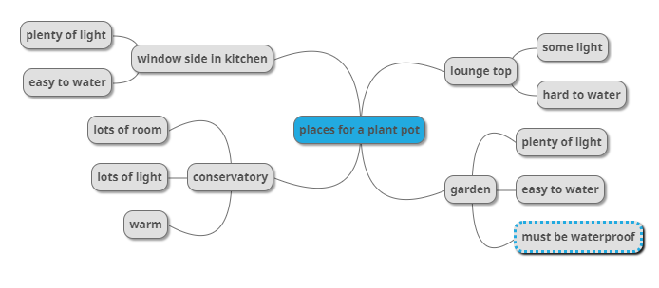
Planter Project : Mind Map
Using what you have learned from your research complete a mid map similar to the one above.
If you want to make one like the example above, you can go to this website to create your own mind map and copy on to paper if you like. https://app.mindmup.com/

Slide 9
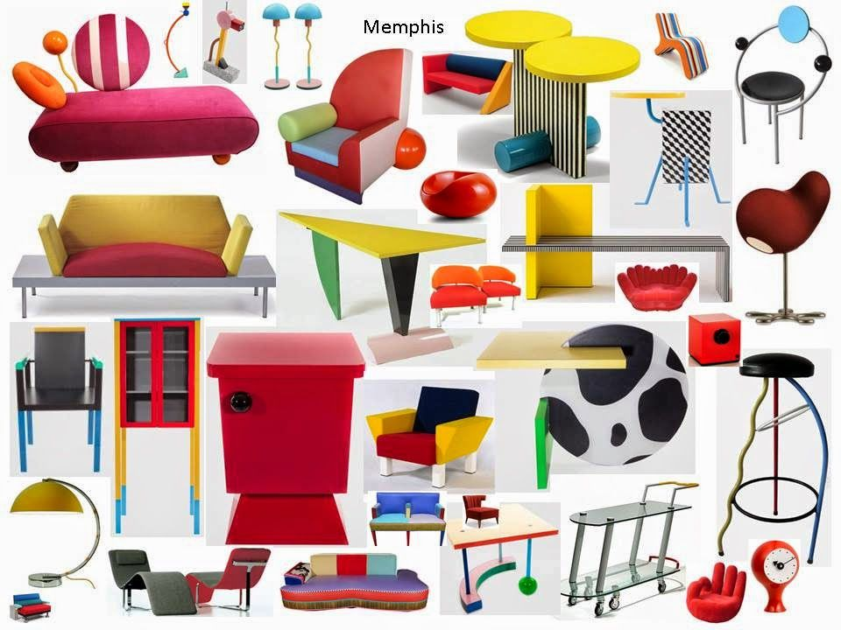
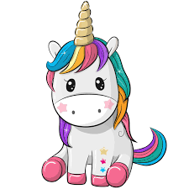
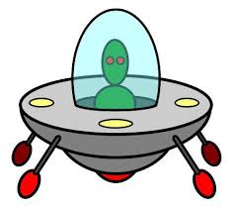
Planter Project Design Ideas Mood Board
Now its time to get creative!
Not everyone can come up with ideas easily – a creative thinking technique called random input can be useful for getting ideas. You get something random and then try to turn it into a product. You can create a collage of images that you like by copying and pasting them on to a page. Cutting them out of old magazines and papers and sticking them down or sketch them.
Some random things to get you going

Slide 10
Planter Project My Mood Board

Slide 11
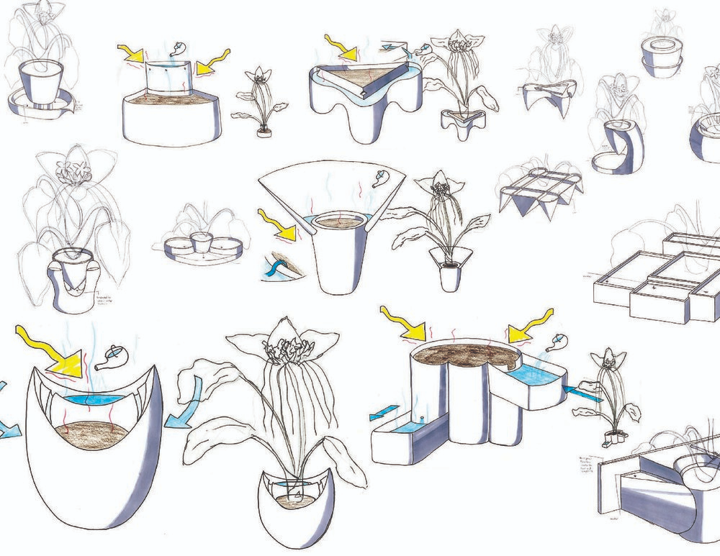
Planter Project My Designs
Now select one of your ideas from your mood board and draw it in 3D using shading and annotations – explain why you have selected this idea.
The following videos will help you with concept sketching
https://www.youtube.com/watch?v=_uzSMAI5AuE&t=291s
https://www.youtube.com/watch?v=zPDbca83V5Y
https://www.youtube.com/watch?v=FLrCO4K2Wkw
https://www.youtube.com/watch?v=hdTTz6ZaCXs

Slide 12
Planter Project My Designs

Slide 13
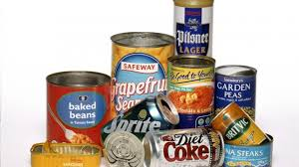
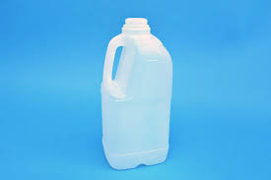
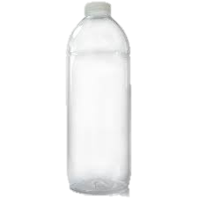
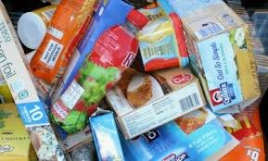
Planter Project Making My Best Design
So now you’ve gathered your recycling you may have items such as the following. Your job now is to use scissors carefully! And tape of any kind to start creating your plant pots.
Things to consider;
Is the material waterproof?
Can you hold soil and water in it?
Can it be decorated?
https://www.youtube.com/watch?v=OJJvghf1E7A
This video might help
Plastic bottles | Good for holding soil and waterproof, good shape for rockets, minions etc.
cans | Good for holding soil and water, good for small pots. (be careful get an adult to help you as these can be sharp)
tins | Good for holding soil and water medium sized pots (be careful get an adult to help you as these can be sharp)
cardboard | Good for decorating the outsides with shapes and features.
You should test the materials first before using them

Slide 14
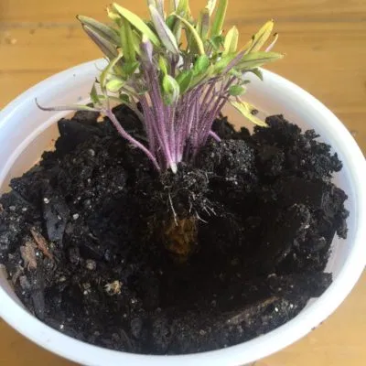
Planter Project Evaluating my project
So, now its time to test and evaluate your product!
You need to get some soil and pop it in your plant pot. Then if you have seeds pop them in, if you have just 1 tomato then that will work also.
https://www.gardeningknowhow.com/edible/vegetables/tomato/planting-tomato-slices.htm
This article explains how a tomato sliced can grow into a plant.
So you now need to plant the seeds and water them. That’s it! At least for a few days anyway!
What worked well explain
How would you improve it further?
How did you enjoy the project?

Slide 15
And… your done! Well done, enjoy your tomatoes.

