Slide 1
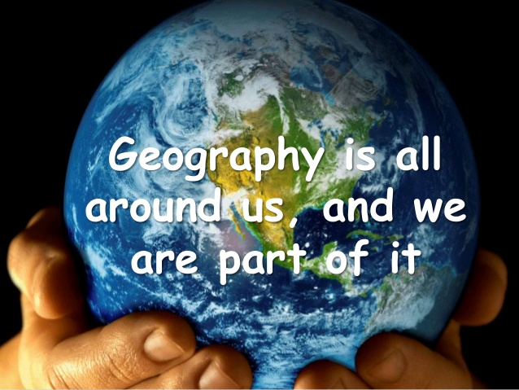
Hello Year 8 and WELCOME to the study of Geography at Monkseaton High.
#Geography4Life ☺
To get you thinking about LOCATIONS & ISSUES that are part of the Year 9 course, here are some tasks to help you discover our country and environmental issues.
When you complete the tasks, please email your work to:
Y8transition@monkseaton.org.uk
Notes:
Play song on entry

Slide 2
Task 1
“UK Map Quiz”
Using your general knowledge, the internet, an atlas or all three, look at the map on the following slide and identify the many features of the British Isles …

Slide 3
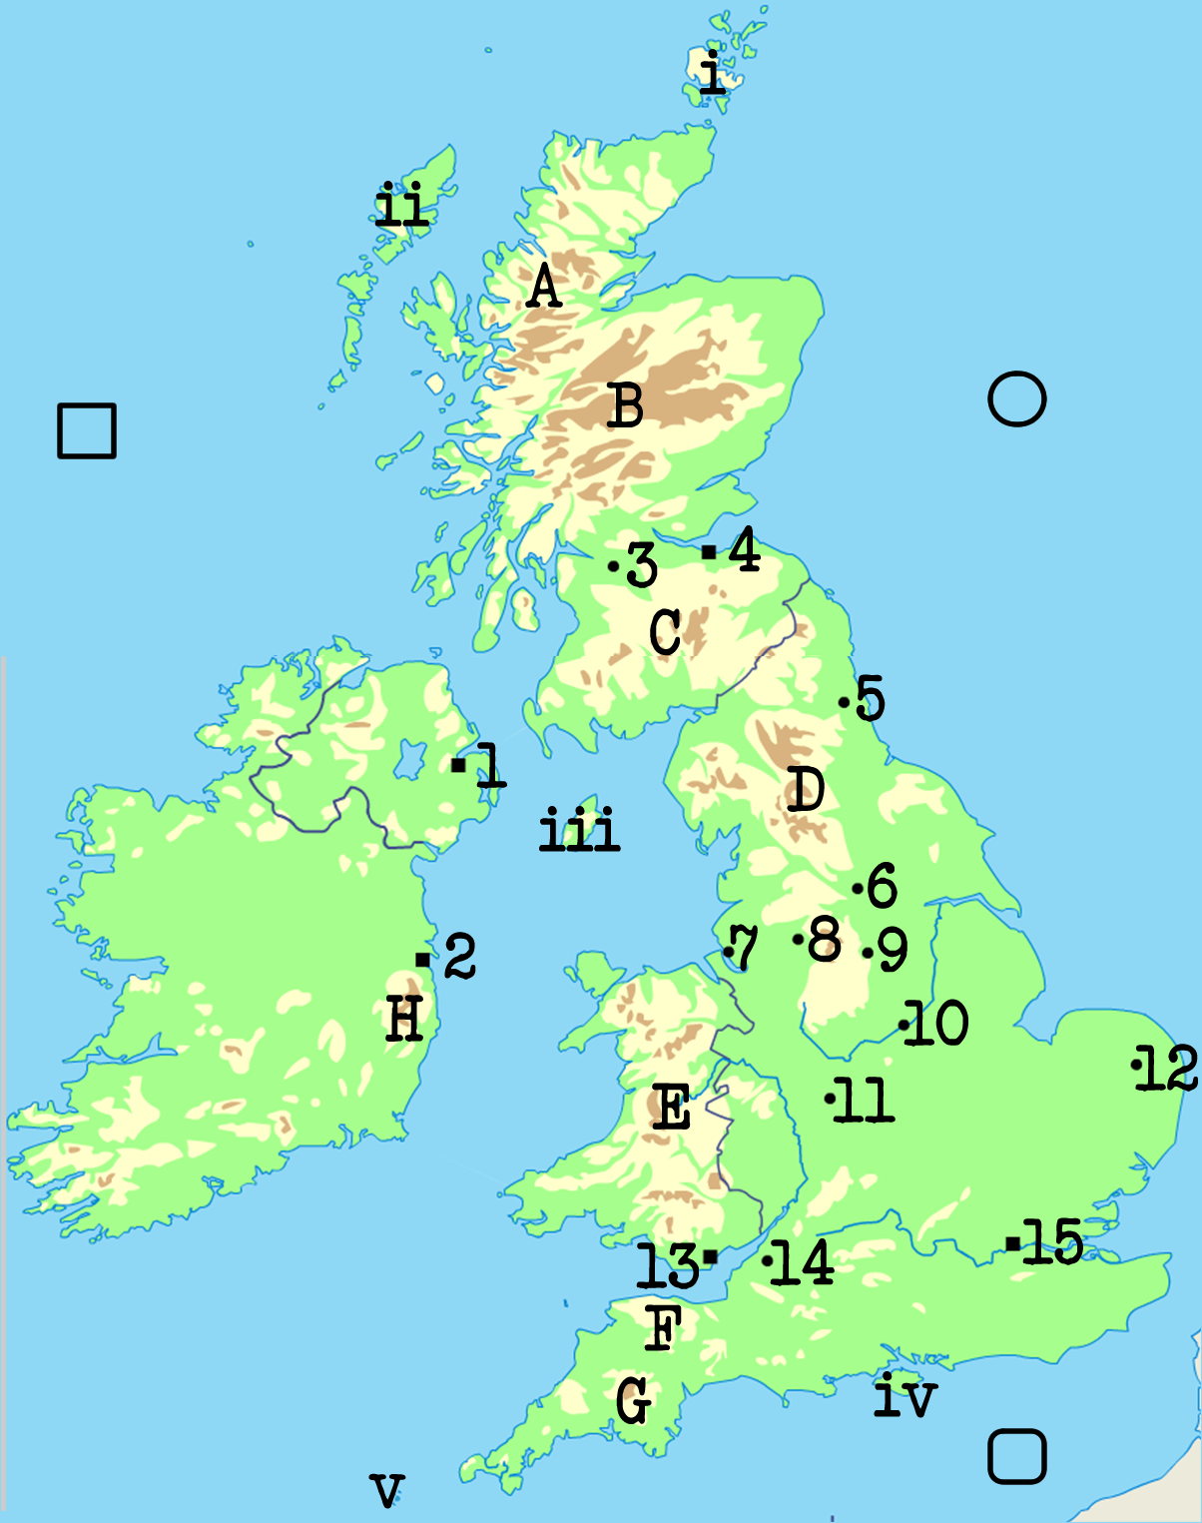
Name the high land areas:
A
B
C
D
E
F
G
H
Name the towns and cities:
1
2
3
4
5
6
7
8
9
10
11
12
13
14
15
Name the islands:
i
ii
iii
iv
v
Name the seas:
Which three rivers can you see?
Which individual countries can you see?

Slide 4
Task 2
“Environmental Issues –
Traffic Congestion Solutions”
Look at the slides which follow and complete a grid like the one at the end to identify the strategy being used, how it works and whether it is any good.

Slide 5
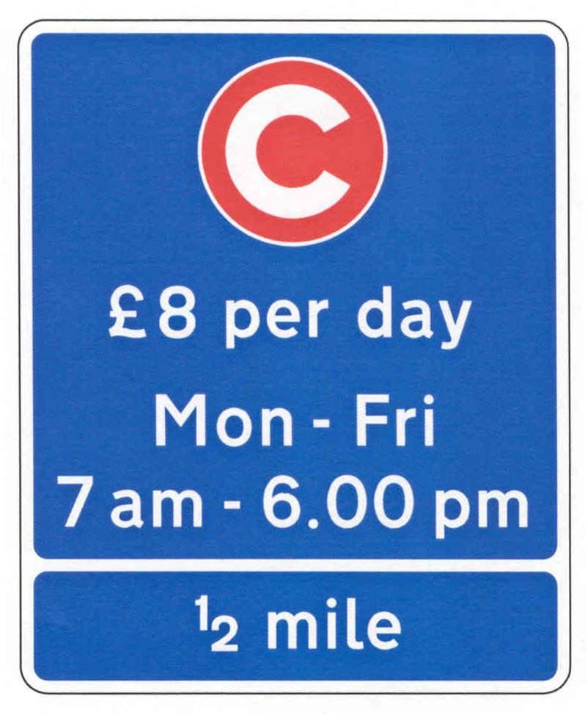
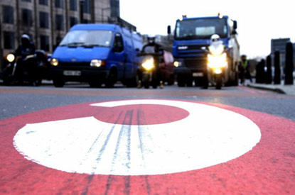
1

Slide 6
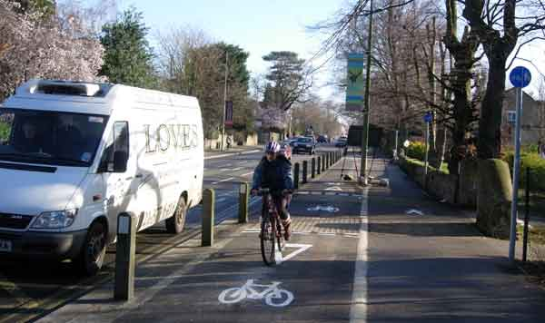
2

Slide 7
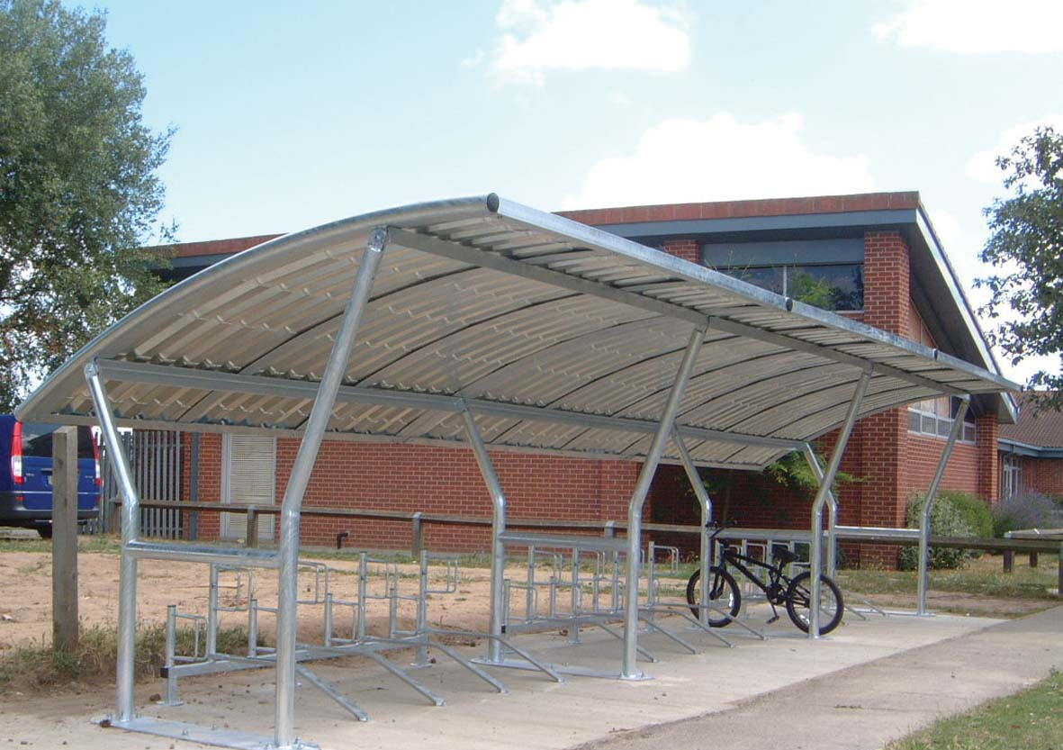
3

Slide 8
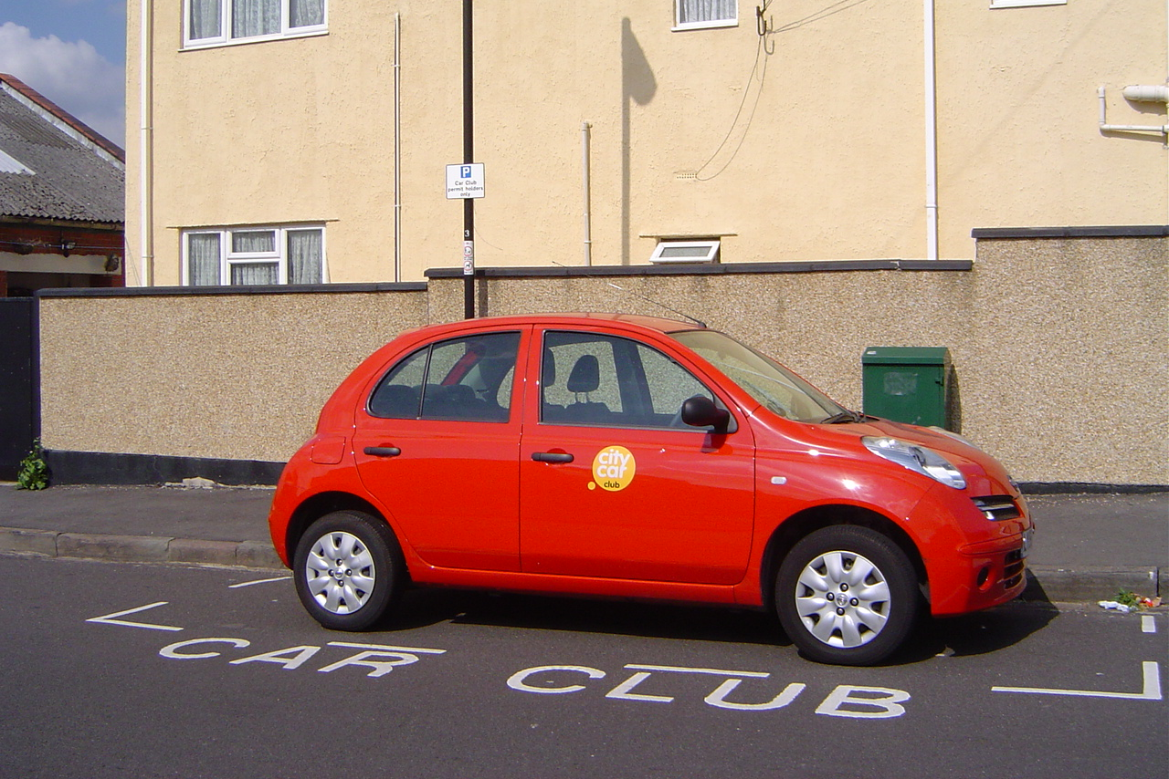
4

Slide 9
5

Slide 10
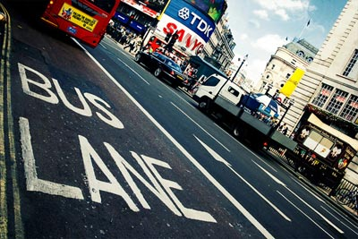
6

Slide 11
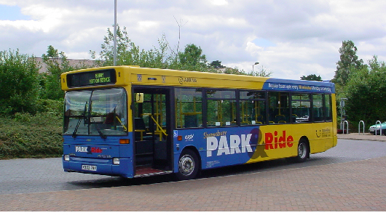
7

Slide 12
8

Slide 13
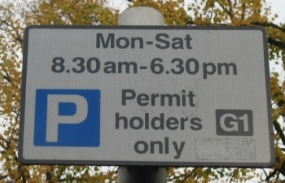
9

Slide 14
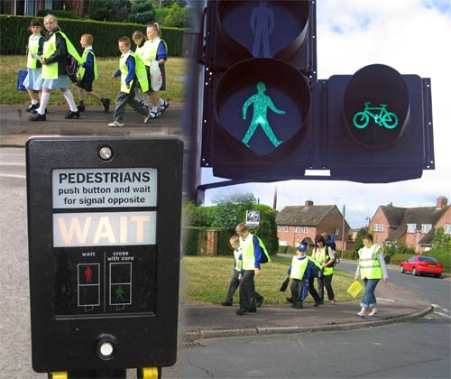
10

Slide 15
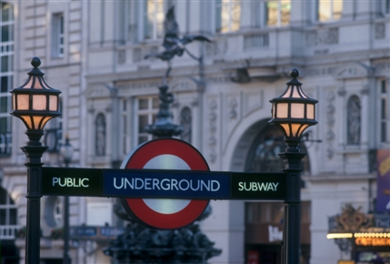
11

Slide 16
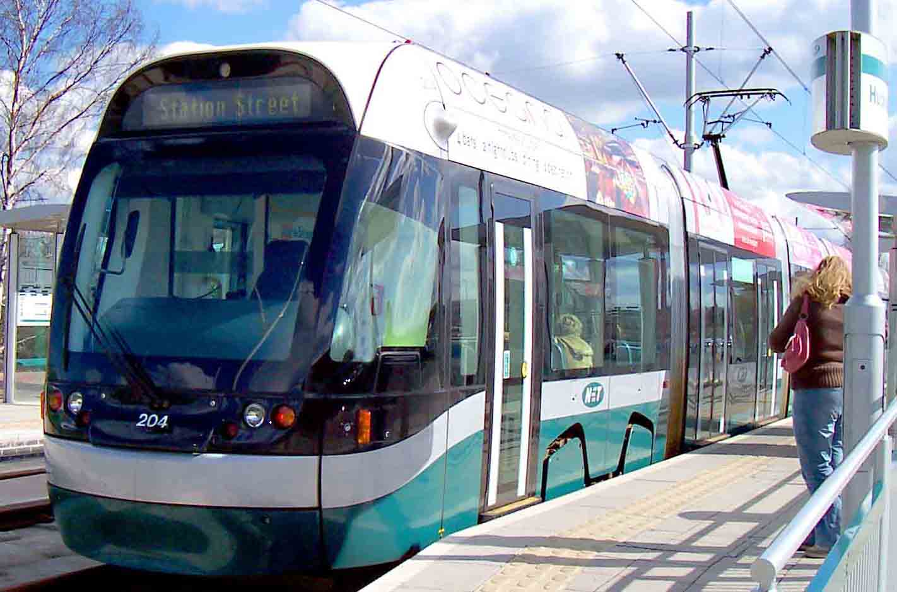
12

Slide 17
13

Slide 18
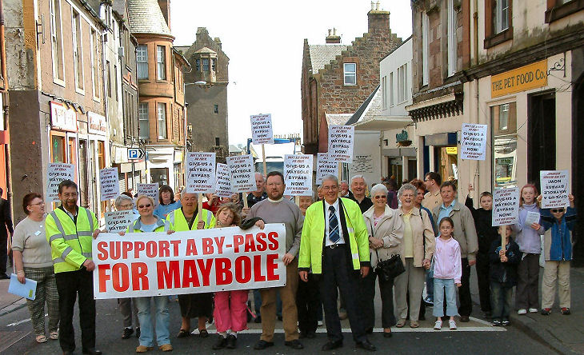
14

Slide 19
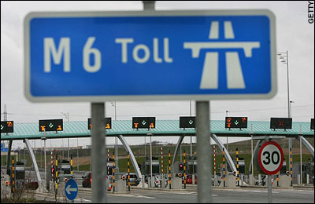
15

Slide 20
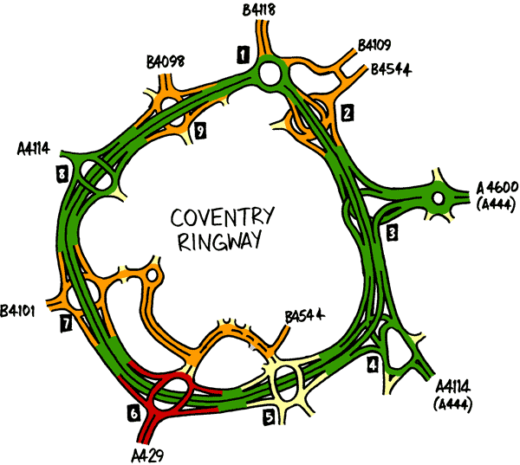
16

Slide 21
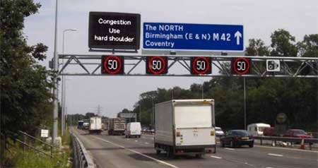
17

Slide 22
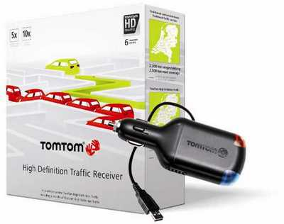
18

Slide 23
19

Slide 24
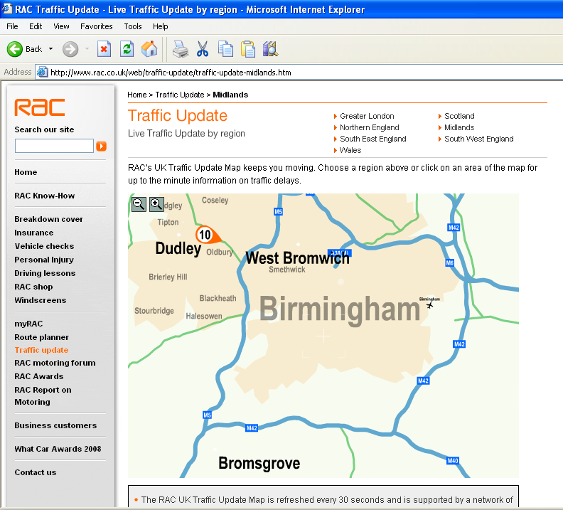
20

Slide 25
 | Strategy | How it works | Is it any good? Why/why not?
1
2
3
4
5
6
7
8
9
10
 | Strategy | How it works | Is it any good? Why/why not?
11
12
13
14
15
16
17
18
19
20

Slide 26
Task 3
“ Traffic Congestion Solutions in the North-East”
Look back at the slides.
Have you seen any of these strategies near your home? Which ones and where?
Which strategies do you think would work best in this area?

Slide 27
Task 4
“Geography skills –
map reading and grid referencing”
Look at the map and legend (key) then answer the questions which follow.

Slide 28
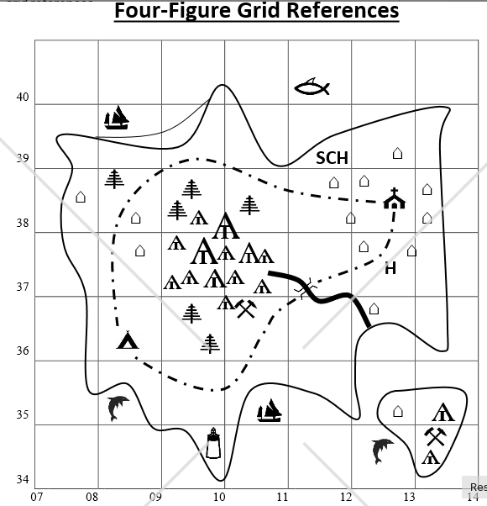

Slide 29
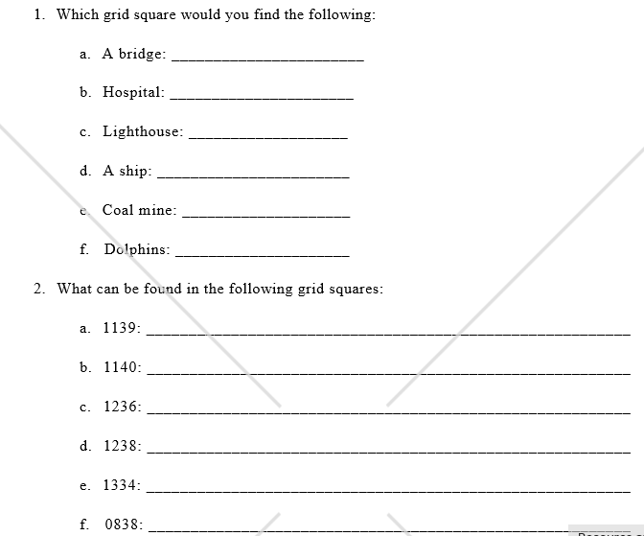
1137
Grid references start with the number on the horizontal axis and end with that on the vertical axis – the first one has been done as an example

Slide 30
Task 5
“Physical Geography”
Look at the pictures on the following slides then identify and describe the methods used to protect against coastal erosion at Whitley Bay.
For each method – research and explain why it is used.
https://www.bbc.co.uk/bitesize/guides/z2ym82p/revision/2
https://www.youtube.com/watch?v=TYQ--nTcNU8
https://www.youtube.com/watch?v=AyhWls9Nhq0
http://www.thejournal.co.uk/north-east-analysis/analysis-news/crumbling-whitley-bay-sea-cliffs-7858147

Slide 31
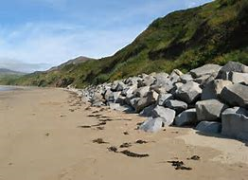
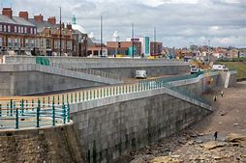
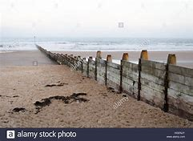
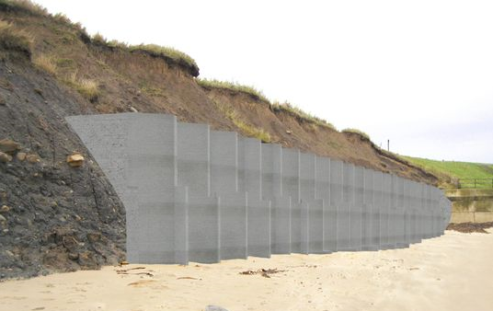
A
B
Match the following terms with the correct picture:
1.Groynes
2.Rock Armour
3.Sea wall
Near St. Mary’s lighthouse
C
D
Near St. Mary’s lighthouse
Blyth

Slide 32
Task 6
“Geography skills –
map reading and analysis”
Look at the map of Whitley Bay (next slide) and the area around it – use Google Maps to zoom in and see the detail.
Create an advert for the area – with images and 150 words to promote the physical (land) and human features of this area.

Slide 33
