Slide 1
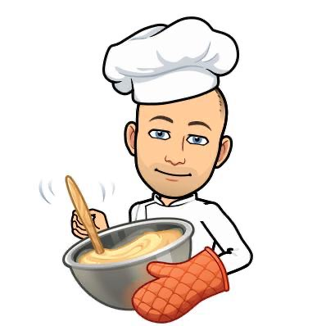
Welcome to Hospitality
In Hospitality, you will be able to prepare lots of tasty recipes and practice your cooking skills. We look at lots of different topics in Year 9 including healthy eating, where our food comes from and environmental issues.
We have two brilliant food rooms that you will be able to cook in and we will see you once a week for Hospitality lessons.
We also run Cooking Club after school for any budding chefs!
The three staff who will be teaching you are:
Mrs Carr- Thoms, Mr Lazell, Mrs Weites.

Slide 2
It can be a Scary time so I thought I would give you a few challenges that will hopefully make you and your families laugh.
On the next few pages you will find some fun challenges inspired by Monsters for Hospitality.
The challenge is split into 3 areas:
- Research and Analysis
Design Ideas
Making

Slide 3
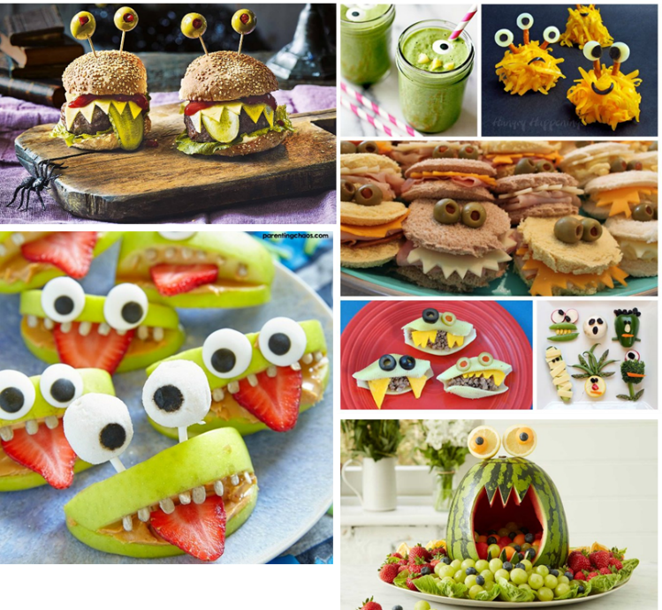
Task 1. Mood board 20 mins
Create a mood board based on the theme of monsters – gather a range of different images as this will help inspire your own design ideas.
Use google images to find pictures of Monster Food. You can sketch examples instead if you want. Remember to make it colourful!

Slide 4
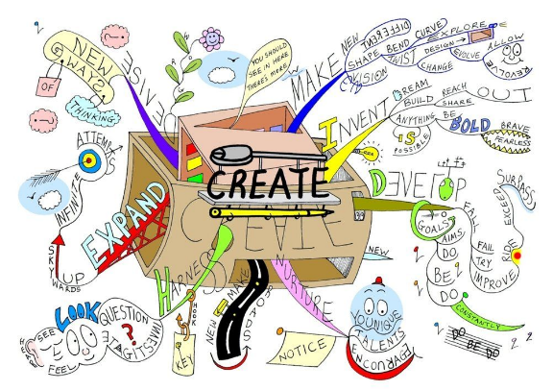
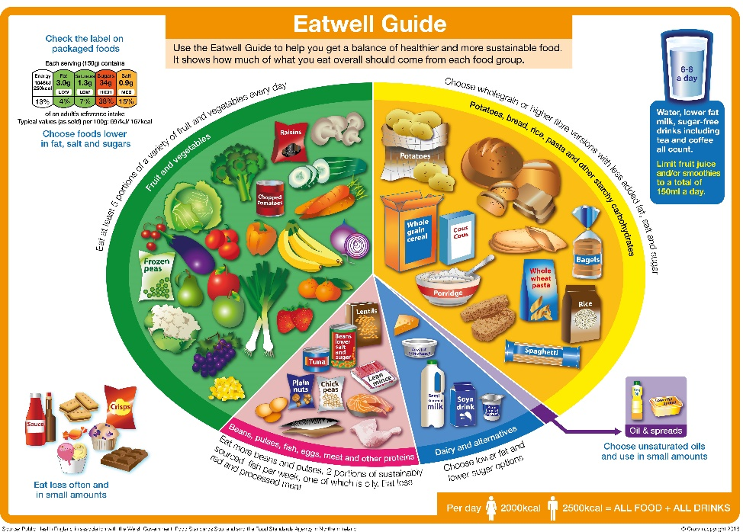
Task 2. Mind Map 20 mins
Create a mind map based on the theme of monsters – think about the following areas: colour, shape, user, ingredients, theme etc.
You may refer to your mind map or any famous monsters from film/TV to develop your own ideas.
Include information of what food you could use and how you could assemble it together.
Complete your mind map digitally or on paper. Make it as visual as possible with small images, sketches and colour.
Refer to the Eat Well Guide and explain how you could create a balanced meal from your ideas.

Slide 5
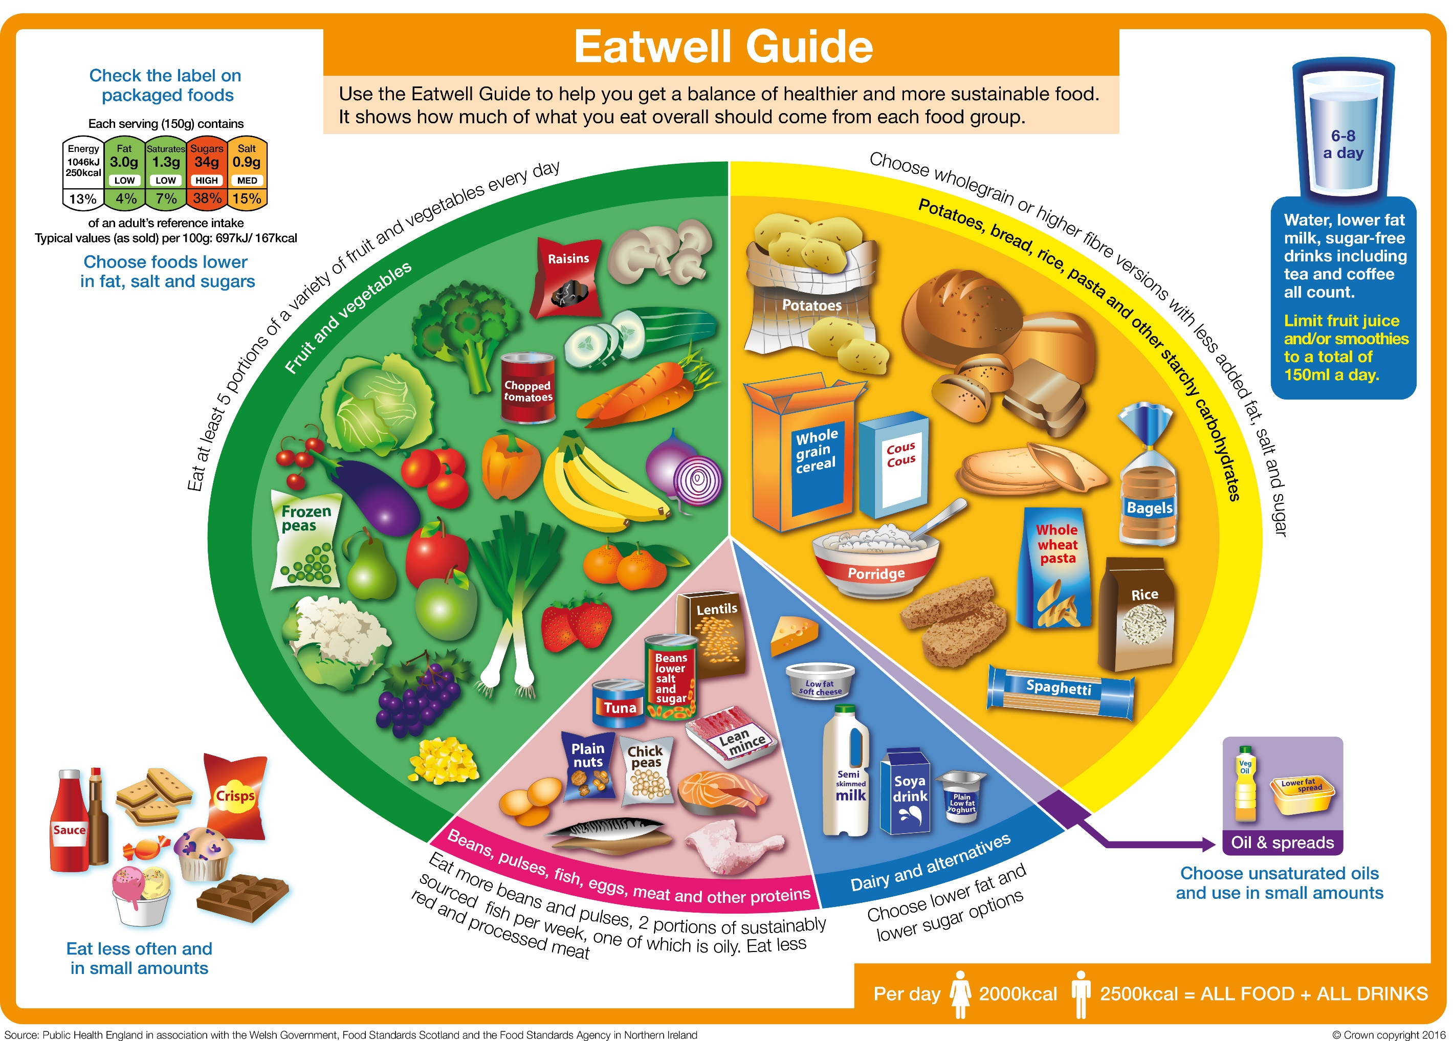

Slide 6
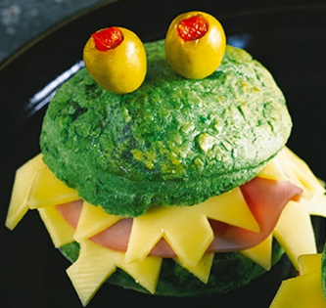
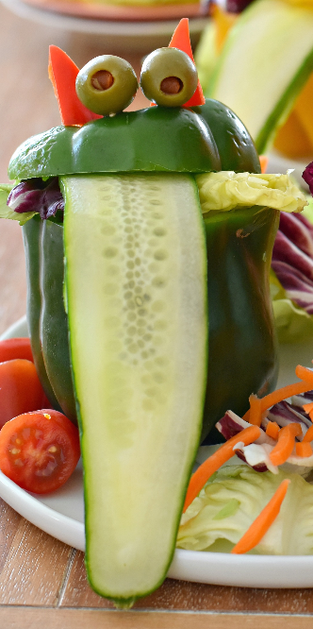
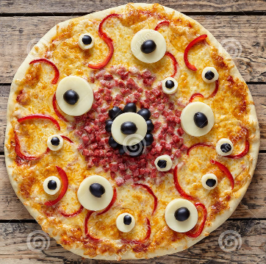
Task 3. Analysis 15 mins
Look the images below of a Monster Food. Come up with as many good things and bad things about the Monster Food.
Create a small table and bullet point your ideas. Use the sensory adjectives on the next slide to help you.
Challenge: to think of 3 ways the Monster Food could be improved. Refer to the Eat Well Guide.

Slide 7
Sensory Analysis adjectives
Appearance
Aroma
Flavour
Texture
Attractive
Bright
Browned
Bubbly
Cheap
Chunky
Clear
Cloudy
Coarse
Colourful
Colourless
Crisp
Crumbly
Delicate
Dry
Dull
Firm
Flaky
Flat
Fluffy
Foamy
Fresh
Glossy
Golden
Greasy
Grainy
Hard
Healthy
Heavy
Hot
Limp
Lumpy
Moist
Mottled
Mushy
Nutritious
Opaque
Plain
Powdery
Risen
Runny
Shiny
Sloppy
Smooth
Soggy
Sticky
Stringy
Acidic
Acrid
Aromatic
Bitter
Bland
Burnt
Cheesy
Citrus
Fatty
Floral
Fragrant
Fresh
Lemony
Mild
Minty
Musty
Pungent
Rancid
Rotten
Savoury
Scented
Sickly
Spicy
Strong
Sweet
Tainted
Tart
Weak
Zesty
Acidic
Aftertaste
Bland
Bitter
Burnt
Buttery
Cheesy
Citrus
Cool
Creamy
Dry
Fatty
Flavoursome
Fresh
Fruity
Heavy
Hot
Light
Meaty
Metallic
Mild
Minty
Nutritious
Nutty
Plain
Rancid
Rich
Salty
Savoury
Sharp
Sickly
Sour
Spicy
Stale
Strong
Sweet
Tainted
Tangy
Tart
Tasteless
Tasty
Undercooked
Warm
Weak
Zesty
Bouncy
Brittle
Bubbly
Chewy
Chunky
Clammy
Coarse
Crispy
Crumbly
Crunchy
Dry
Elastic
Firm
Fizzy
Flaky
Fluffy
Foamy
Gooey
Greasy
Gritty
Hard
Hot
Juicy
Light
Lumpy
Moist
Powdery
Rubbery
Runny
Sandy
Short
Slimy
Smooth
Soft
Soggy
Spongy
Springy
Sticky
Stiff
Stodgy
Stretchy
Stringy
Tacky
Tender
Thick
Thin
Tough
Watery
Warm
Waxy

Slide 8
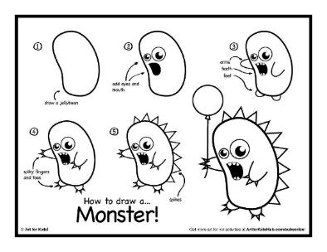
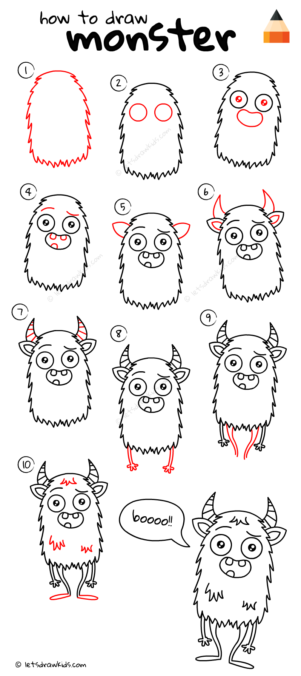
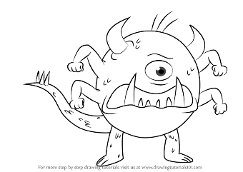
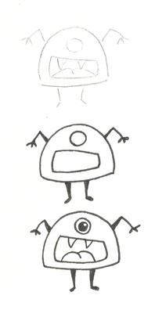
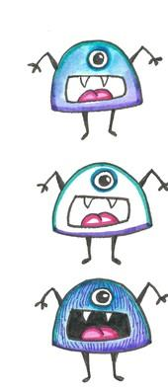
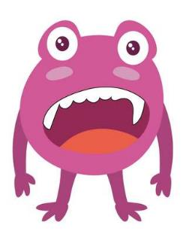
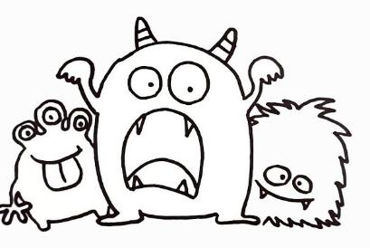
Task 4. Designing 30mins
Practice your drawing skills by creating a unique monster made out of food. Refer back to your mood board and mind map for inspiration!
Remember your drawings should mainly be 3D, drawn neatly with colour.

Slide 9
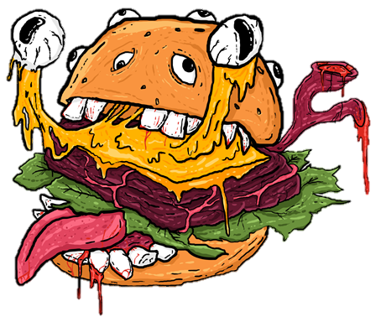
Task 5 . Annotating Design 20 mins
Annotate your design by answering the following questions. Challenge questions are highlighted in green.
Make sure to write in full sentences and in detail. Check your spelling and grammar.
4. If the product was packaged, what would you use and would it be
recyclable?
Are the ingredients in your product biodegradable?
Does the product or any of the
equipment or resources you have used harm the environment?
1.Who is the target customer and how does is appeal to them?
How could the design be changed to suit a wider range of customers?
2. What ingredients will you use used to make the product?
Do they need to be prepared in any way?
Can you suggest other suitable ingredients that could be used?
How could you make your meal balanced or more healthy? Refer to Eat Well Guide.
3. Is the product safe?
What steps will be taken to ensure that the product is safe?
How will you ensure your own safety during its manufacture?
5. What is successful about your design and why?
How could you improve your design and why?

Slide 10
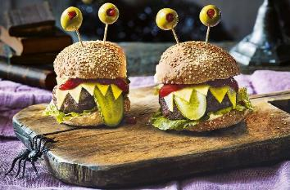
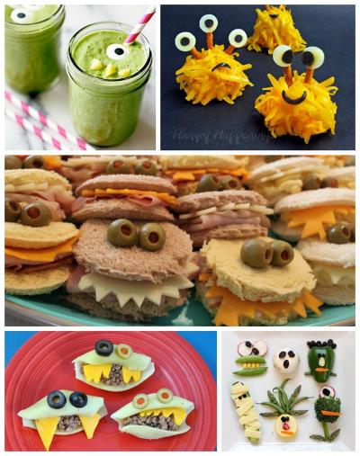
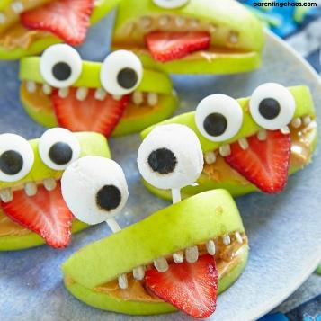
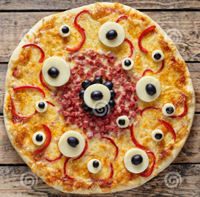
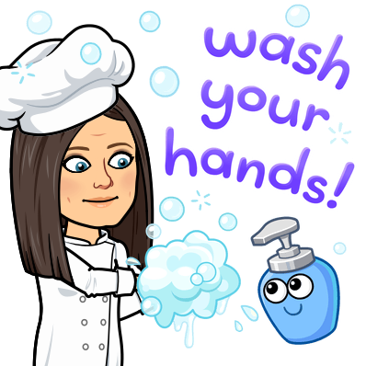
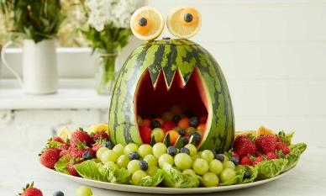
Task 6. Make your Monster Food Optional
Feed your family and make them smile by creating your Monster Food.
Remember to wash your hands and follow hygiene rules.
Please email any photos to Y8transitionmonkseaton.org.uk

Slide 11
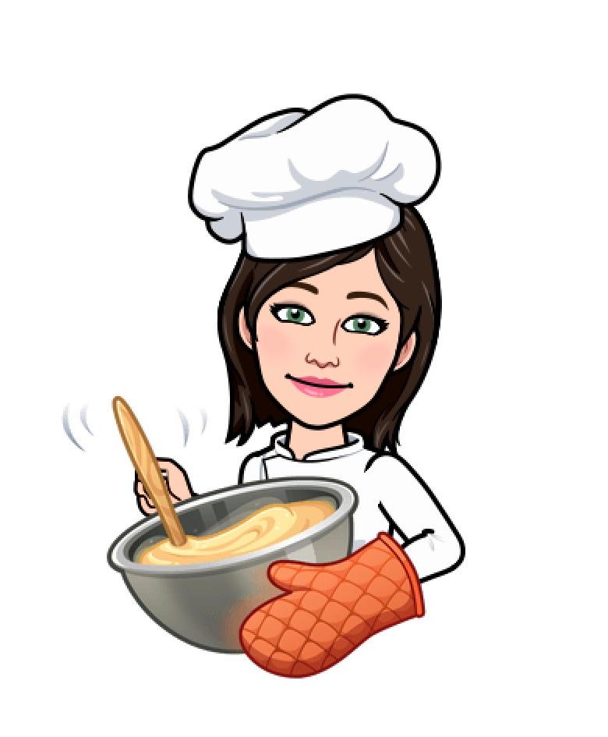
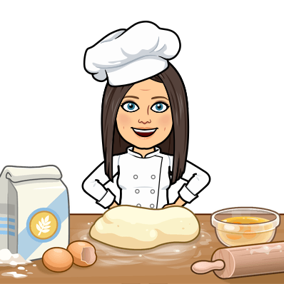
We are all looking forward to meeting you in September and finding out which foods you enjoy preparing, cooking and eating!
Please email us to tell us what recipes you would like to make and which recipes you have made at school and at home.
Y8transitionmonkseaton.org.uk
Bye for now,
Mrs Carr-Thoms, Mr Lazell and Mrs Weites

