Slide 1
Year 8 Transition Booklet
ICT and Computer Science

Slide 2
Hello!
Welcome to Monkseaton High School’s ICT and Computer Science lessons. We look forward to teaching you in September.
This booklet has some fun activities you can try to get you ready for Year 9 while you’re learning from home.
You do not need to complete them all, but they are designed to help you get a head-start on the learning you will do at high school.
We hope that you and your families are keeping well.
Mrs Holmes-Long and Mr Hall

Slide 3
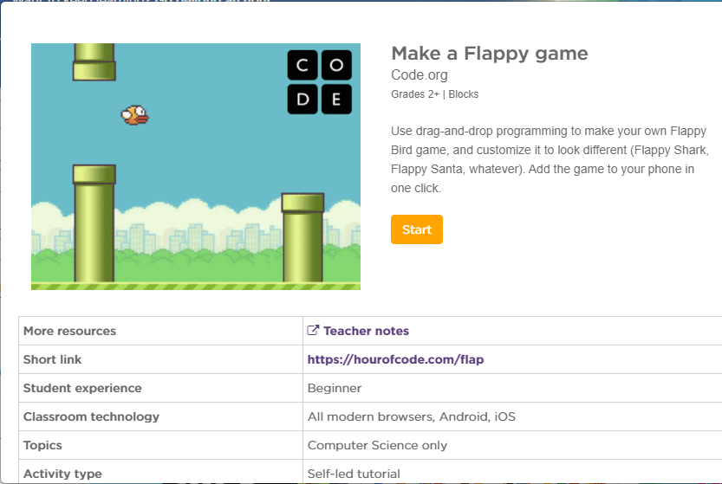
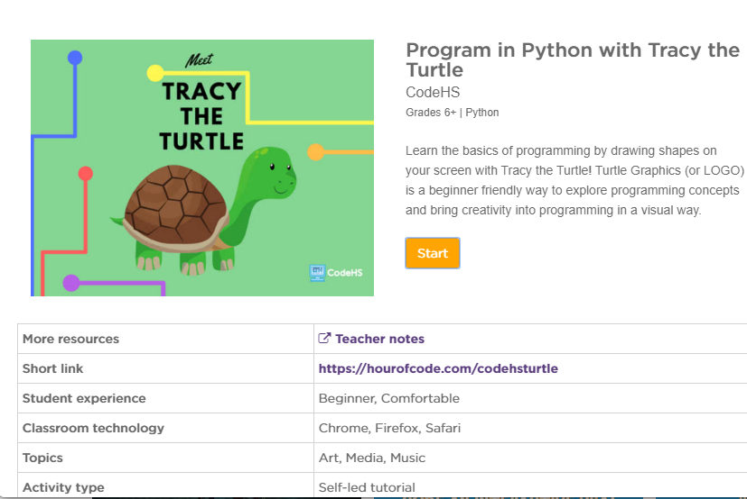
Hour of Code
Use the HOUR OF CODE tutorials to create games and practice your coding skills
Make a Flappy Game
Program in Python with Tracy the Turtle
https://hourofcode.com/flap
https://hourofcode.com/codehsturtle
DIFFICULTY

Slide 4
Programming App
Download the app ‘py’ from the app store / the play store and practice coding in the python language.

Slide 5
Key Words
Use the line tool to mark off words as you find them.
We’ve done the first one for you.

