Slide 1
Maths @ Monkseaton High School
Work through the slides trying to answer as many questions as you can (don’t worry if you can’t do them all) – you can either type your answers into the PowerPoint and send it to us or just send your answers by typing them in your email. You should send your work to Y8transition@monkseaton.org.uk

Slide 2
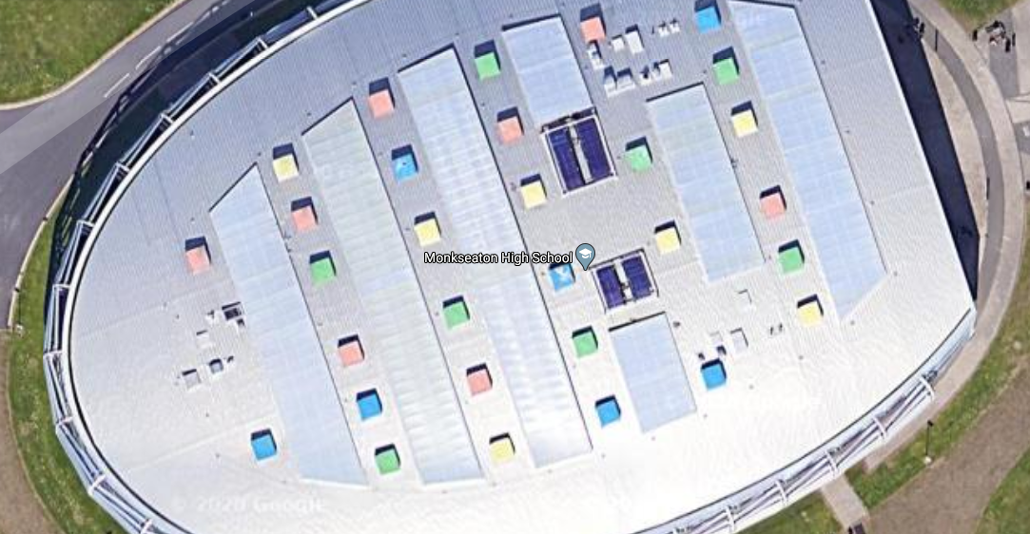
Roof
Here is Google Maps view of the roof of the school – the coloured blocks are part of the cooling system
How many blocks are there?
What fraction are blue?
What is the ratio of yellow to green?

Slide 3
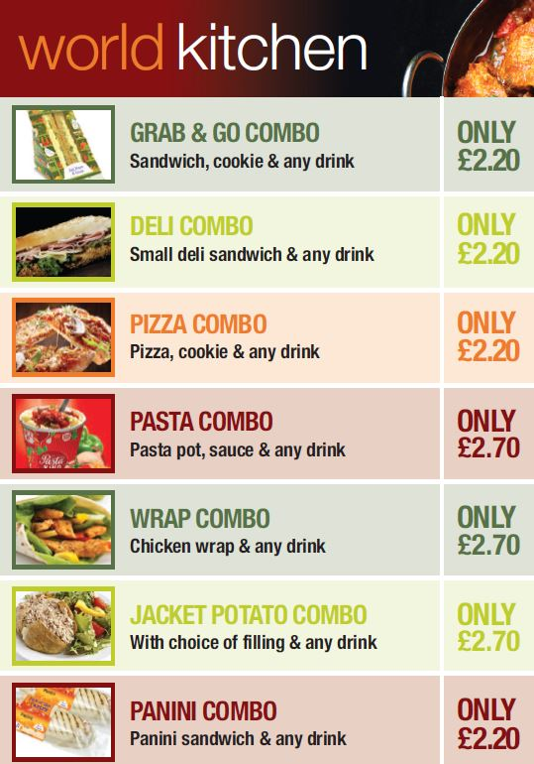
Menu
Here is part of the menu available at Monkseaton High School
What is the difference in price between ordering the cheapest Combo and the most expensive Combo?
How much cheaper would it work out across a week?
How much cheaper would it work out across a full school year?

Slide 4
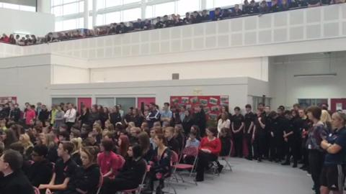
Atrium
Pictured is our atrium which is at the front of school and a nice spot to relax during break and lunchtimes (we also have events in there occasionally)
If the dimensions are approximately 24m by 18m what is the total area of this space?
If each student needs 1.5m² space, what is the most amount of students that could fit in here?

Slide 5
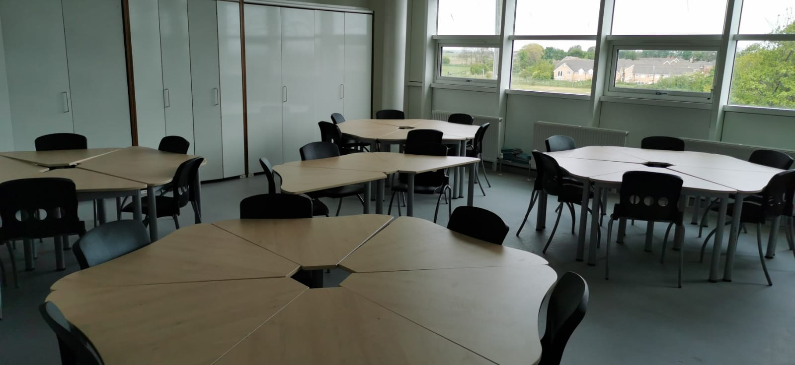
Classroom
Here is a typical classroom at MHS
Look at the desks
When six of them are put together what regular shape is the hole in the centre?
How many seats can you see? How many do you think are in the room altogether?
If each classroom has the same number of seats, what is the maximum number of students that can fit in total in the four Maths classrooms?

Slide 6
RESPECT Points
At MHS you have the opportunity to gain RESPECT points
These can then be cashed in for rewards
If you were on 30 points and get another 20% of that in one week how many are you on?
If you need 160 for a particular reward and are currently on 40, what percentage of the reward do you currently have?

Slide 7
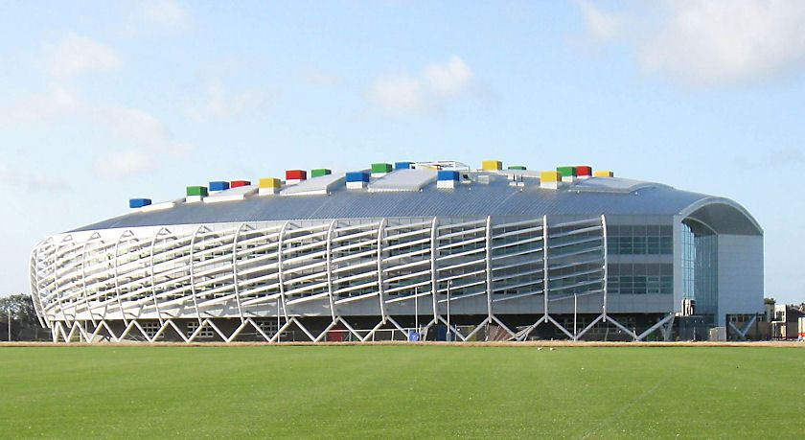
Building
Look at the picture of the building – there are 3 floors of rooms and independent learning areas
Estimate how high you think the building is
Measure the height of a step in your home
(Or Google the typical height of a step if you don’t have any)
How many steps would be needed to get as high as Monkseaton High?!

Slide 8
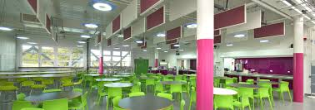
Canteen
Look at the picture of the canteen
If the circular tables have a diameter of 2m, what is the circumference of each table?
Each chair needs 80cm of space around the circumference to fit properly. What is the most chairs that should fit around one table?
Look at the tables in the photo. Estimate the most number of seats that can be put around them in total

