Slide 1
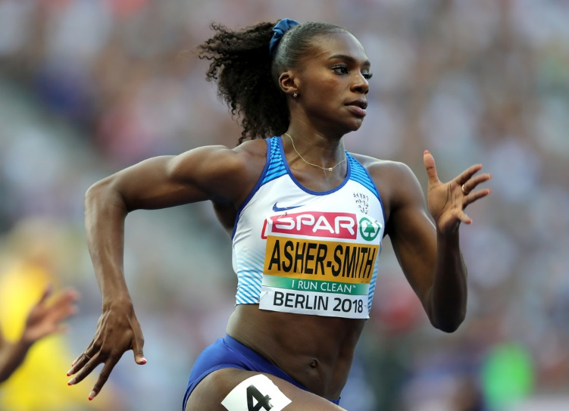
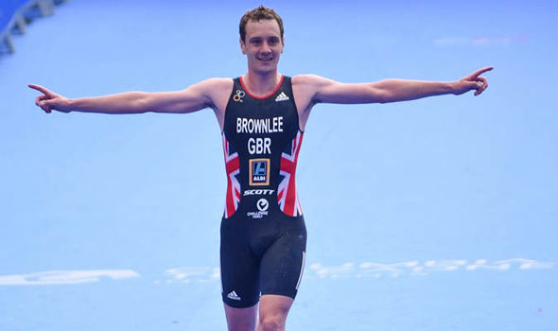
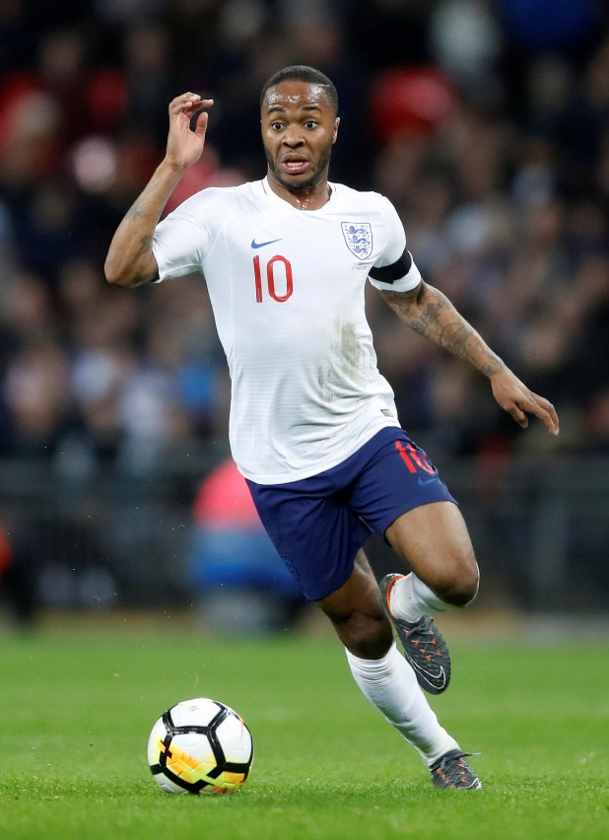
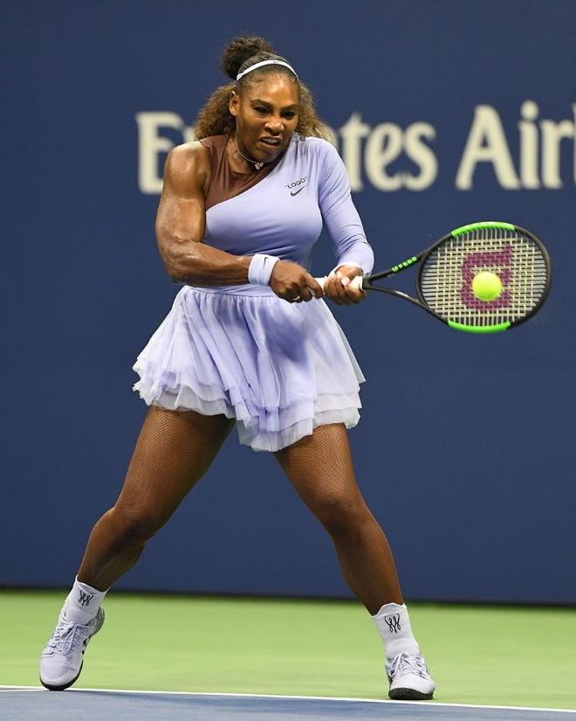
Monkseaton High Y9 PE
Dina Asher Smith - 100 and 200m sprinter
Alastair Brownlee – triathlete legend
Our PE Champion Athletes
Raheem Sterling – England and Man C football supremo
Serena Williams – most successful female player of all time

Slide 2
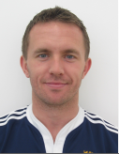
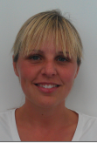
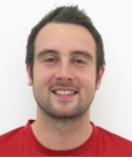
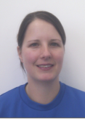
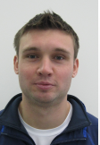
Your Fantastic PE Team
Mr Johnson Miss MccAllum Mr Hay Mrs Shorting Mr Helson
Fitness Guru Horse Riding Football Legend Volleyball Queen Triathlon Titan
Superstar
We are very excited to meet you all in September. PE at Monkseaton is fun and challenging and we are looking forward to seeing what you can do. In this power point/booklet there are a number of fun tasks for you to have a go at while learning from home. You don’t have to complete them all, but they are all there to help with your PE knowledge and to help us understand you better before you come up to Monkseaton High.

Slide 3
Task 1: All about you Tell us all about you. Which middle school did you attend? What are you favourite subjects. What sporting activities did you do while at your middle school? Which two sports were your favourite? Who are your role models? Who are your favourite sporting heroes? Do you play and sport or do any other activities outside of school like play for a sports team or play an instrument? You can print this slide off, complete it on a computer or create your own personal sheet.
All about me

Slide 4
Task 2: The Components of Fitness The components of fitness are the different parts of fitness. There are 11 to learn
All sports have lots of different fitness parts to them. For example a netball player needs speed to sprint past a player but they also need agility to change direction to receive the ball.
We have a saying to help us remember the components of fitness. Each capital letter is the starting letter of a component.
MRS CAP Supports Barcelona Football Club
On the next slide there is a match up task

Slide 5
Components of fitness match up task. Draw a line between the component of fitness and the description you think matches it. Remember MRS CAP Supports Barcelona Football Club
Components MRS CAP SBFC
Muscular endurance |  | The ability to maintain the centre of mass/gravity over the base of support
Reaction time |  | The ability of the heart and lungs to deliver oxygen-rich blood around the body.
Speed |  | The ability to produce a maximal amount of force or effort.
Cardiovascular endurance |  | The ability to use two or more body parts at once while keeping control of the movement.
Agility |  | The ability to rapidly respond to a movement of another player or ball.
Power |  | The range of movement around a joint.
Strength |  | The ability of a muscle or muscle group to repeatedly contract for long periods of time.
Balance |  | The ability to produce a lot of strength and speed at the same time.
Flexibility |  | The ability to change direction quickly and with lots of control
Coordination |  | The ability to move your body really quickly from one spot to another.

Slide 6
Task 3: PE Heroes What do you know about the sports stars on the front page? Write the name of one of the athletes in the middle of the page and add as much detail and information about them that you can. For example, what sport do they play? What position do they play? What successes have they experienced? Which components of fitness do you think they need to be good at their sport? You could also research information like who are they sponsored by. How old are they? How long have they been competing at their sport?
Dina Asher-Smith
Alastair Brownlee
Raheem Sterling
Serena Williams

Slide 7
Task 4: Monkseaton PE Instagram Challenges
Monkseaton High School has an Instagram page with lots of short challenges for both students and staff to attempt @monkseatonhighschool
Your final task is to have a go at as many challenges as you can before starting in September. You can have multiple goes at each of the challenges. Record your scores and tell me how you did when you come in September.
Good luck and we look forward to seeing you in September.
Mr Johnson and the PE team

