Slide 2
Why do refugees come to Britain?

Slide 3
Think …..
What makes someone a refugee?
Where do they go?
How are they received?
What issues might they face in the short, medium and long term?

Slide 4
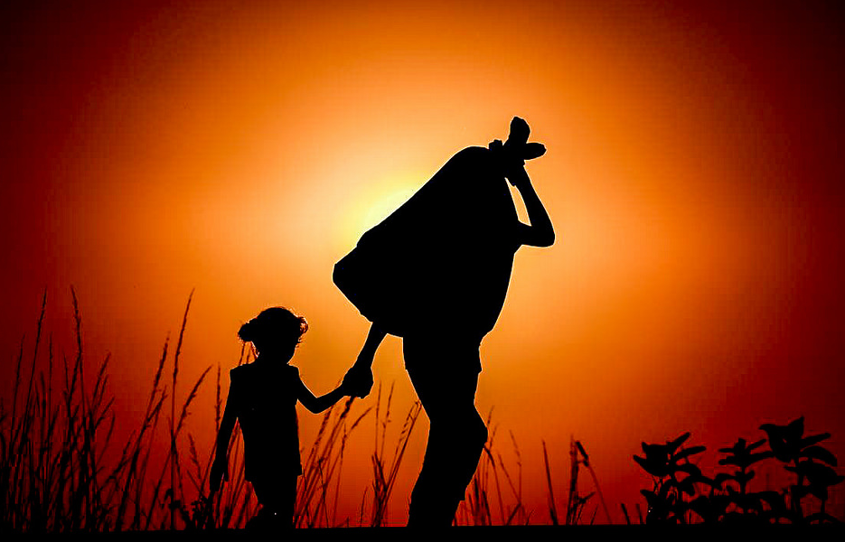
What is a refugee?

Slide 5
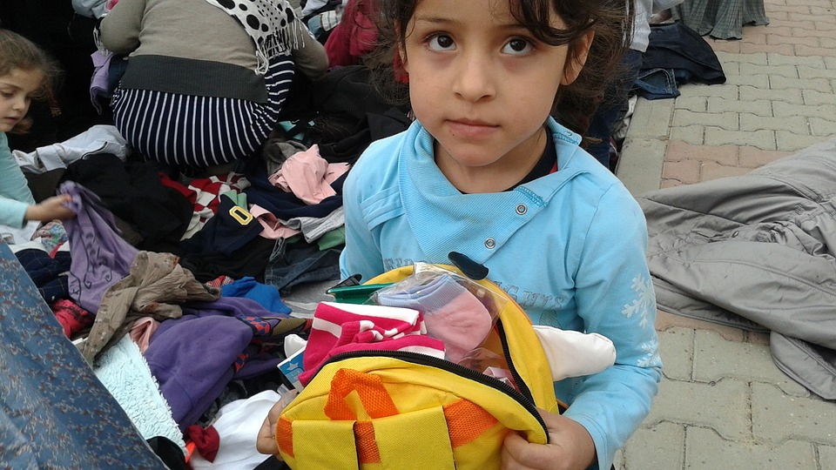
A refugee is a person who has been forced to leave their country for some reason.
Notes:
https://www.flickr.com/photos/jordibernabeu/15596725158/sizes/l

Slide 6
In 2019, more than two-thirds of all refugees came from just five countries: Syria, Venezuela, Afghanistan, South Sudan and Myanmar.
Why do you think this might be?
Notes:
https://www.amnesty.org/en/what-we-do/refugees-asylum-seekers-and-migrants/global-refugee-crisis-statistics-and-facts/

Slide 7
Imagine…
Imagine you have been told that tomorrow you are your family must leave this country forever. Draw a suitcase in the centre of your page and around the outside draw the items that you would take with you into your new life.

Slide 8
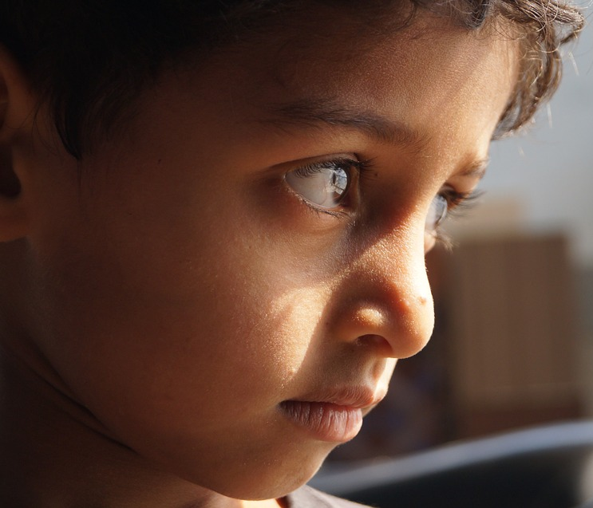
What three things would you miss the most if you had to leave the place and country you live in because of war?
Notes:
https://www.flickr.com/photos/syriafreedom/21245302338/sizes/l

Slide 9
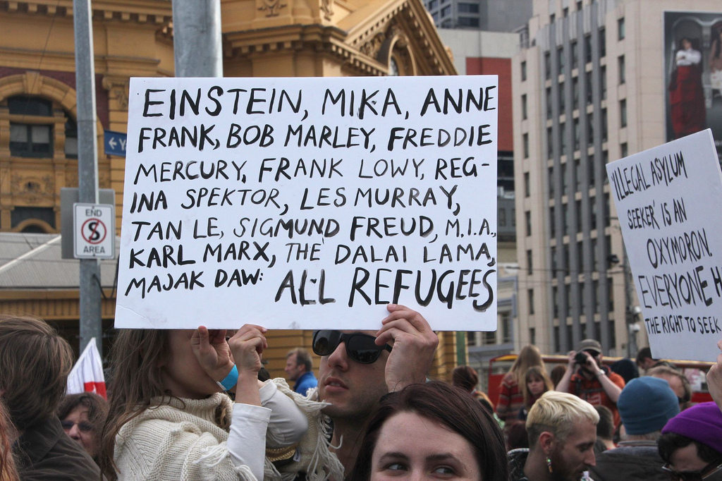
Many famous people are refugees.
Notes:
https://www.flickr.com/photos/takver/9374744871/sizes/l

Slide 10
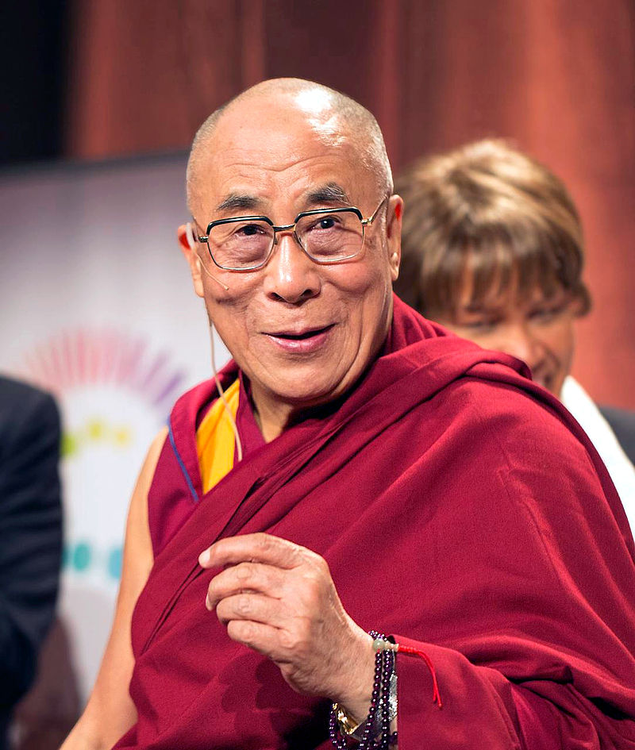
The Dalai Lama,
Tibet’s spiritual leader, fled to India during the 1959 Tibetan uprising, where he currently lives as a refugee.
Notes:
By *christopher* - Flickr: dalailama1_20121014_4639, CC BY 2.0, https://commons.wikimedia.org/w/index.php?curid=22580076

Slide 11
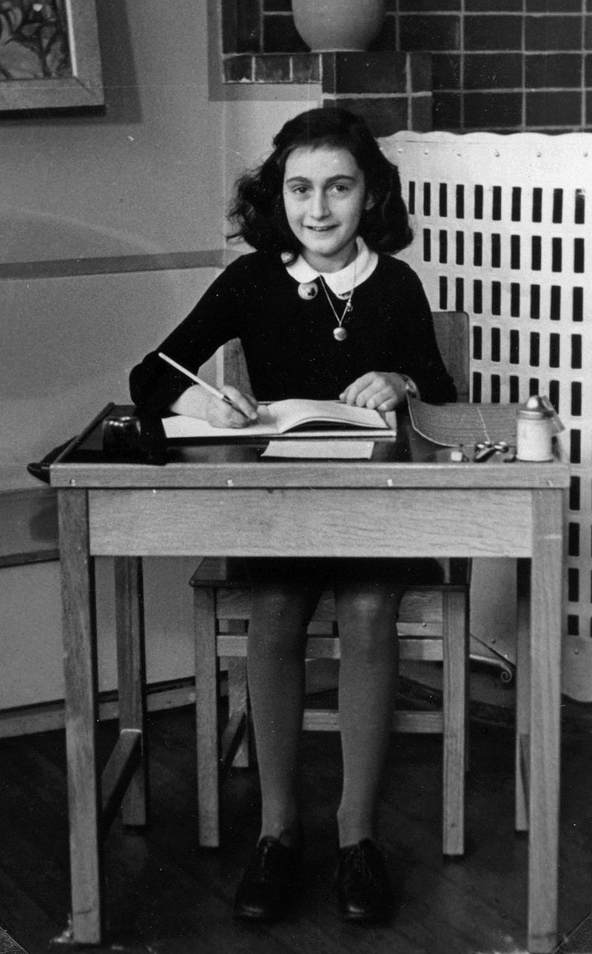
Anne Frank and her family escaped from Germany during the Second World War. She and her family hid for over two years in Amsterdam before they were arrested and deported.
Notes:
https://www.flickr.com/photos/takver/9374744871/sizes/l

Slide 12
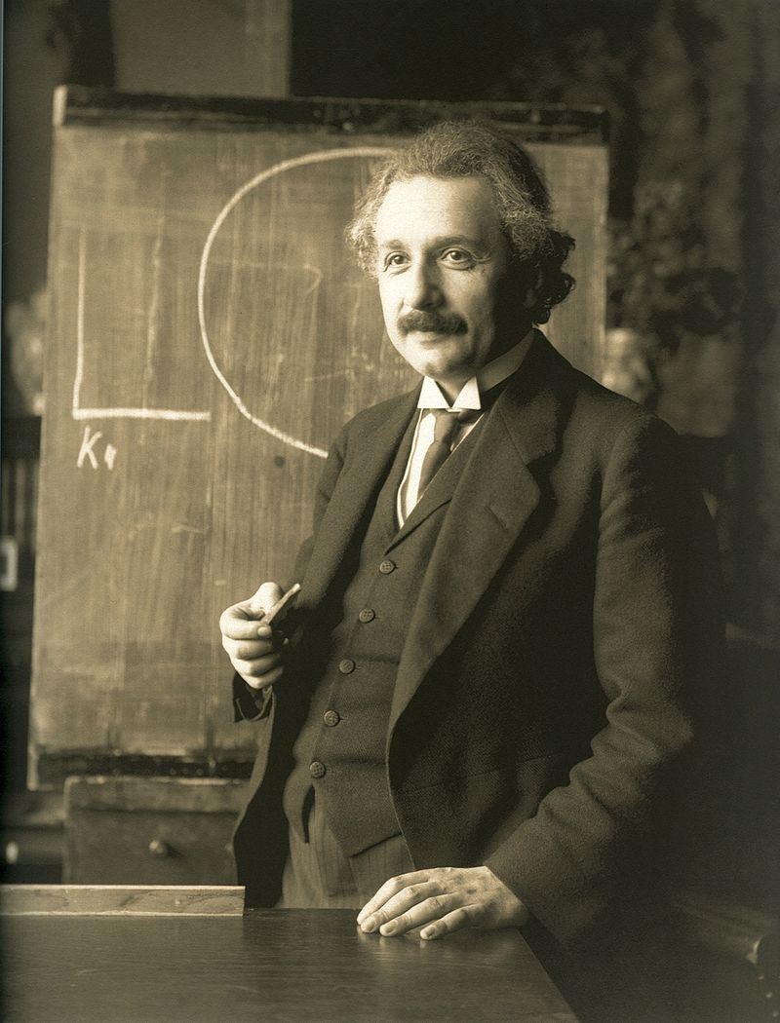
In 1933, when Hitler took control of Germany, Albert Einstein took refuge in America.
Notes:
https://www.flickr.com/photos/takver/9374744871/sizes/l

Slide 13
Lomana Tresor Lua Lua, came to the UK in 1989, a refugee from the Democratic Republic of Congo. He became a successful footballer playing for Newcastle United and Portsmouth. He set up the LuaLua Foundation, which provides care for orphans in the Democratic Republic of Congo.
Notes:
By Ultraslansi - Own work, CC BY-SA 3.0, https://commons.wikimedia.org/w/index.php?curid=29090874

Slide 14
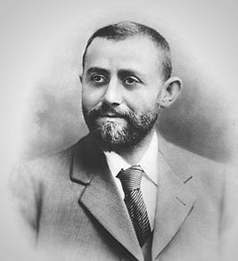
Michael Marks was born into a Polish-Jewish in Słonim. He came to Leeds in England in 1882 as a refugee. He spoke no English. He opened a market stall in Leeds, where everything was sold for 1 penny. He was very successful and opened more market stalls. Then he took on a partner called Tom Spencer. They soon began opening shops all over the country known as Marks and Spencer.
Notes:
https://www.flickr.com/photos/takver/9374744871/sizes/l

Slide 15
Have refugees always come from the same places?
No! Historically people have come to Britain from all over the world, for all different reasons.
Today we are going to investigate where some of these people came from and why they came.
You will be given some information about someone who has come to Britain as a refugee. Read through your information and complete the table for your character.
Be ready to explain your reasons to the class!
Notes:
Groups or pairs ideally

Slide 23
Now identify on your world map where these refugees came from.
**If you are not sure exactly where the country is, try and identify the continent.
CHALLENGE: In a different colour try and locate these 5 countries: Syria, Venezuela, Afghanistan, South Sudan and Myanmar.
Remember in 2019 approximately 2/3 of all refugees came from these countries!
What has changed? Which continents do refugees mostly come from now?

Slide 24
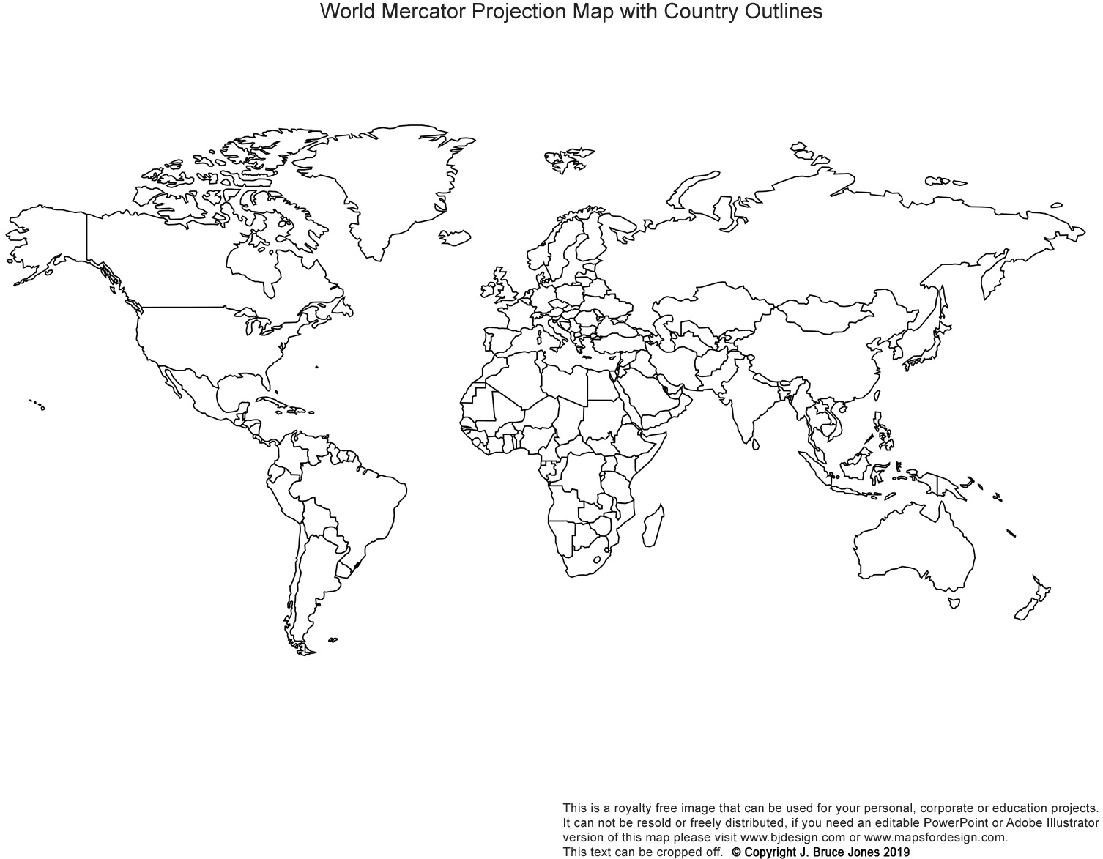
World map

Slide 25
Fact or fiction ….
Over half of refugees worldwide are children.
2 million people worldwide come under the category “refugee”, “returnee” or “displaced person”
1person in every 120 in the world today has been forced to flee his or her home as a result of persecution, violence or war
In the year ending March 2020 around 1.5 million people moved to the UK.
FACT
FICTION – actual number is 26 million
FACT
FICTION – it was around 715,000 and in the same year 403,000 people left the UK.

